Slide 1
PAC ANNUAL CONFERENCE Professional Accounting Futures October 28, 2021
COVID Related Activities and Issues
Jim Kroeker
Vice Chairman, FASB

Slide 2
COVID Related Activities and Issues
Professional Accounting Futures Conference 2021
Jim Kroeker, Board Member

Slide 3
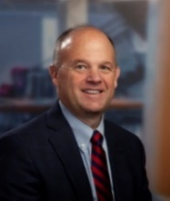
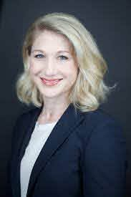
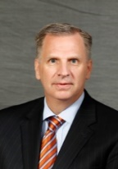
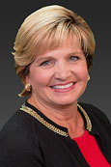
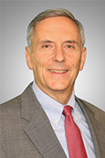
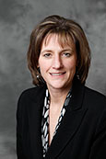
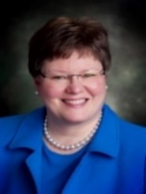
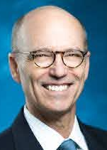
Who We Are
Rich Jones Chair, 2027
Effective July 1, 2020
Hillary Salo Technical Director
Appointed August 2020
Current FASB Board Members
Jim Kroeker
Vice Chair 2024
Christine Botosan 2026
Gary Buesser 2023*
Sue Cosper 2024*
Marsha Hunt 2022*
Fred Cannon 2026*
* Eligible for reappointment for a second 5-year term

Slide 4
FASB Response to COVID-19
Delayed certain effective dates
Provided one-year delays for private-company and certain NFP stakeholders that are implementing major new standards with current or imminent effective dates (Revenue Recognition and Leases)
Proposed and plan to finalize a one-year delay for insurance entities for the new Insurance standard (2022 → 2023 for publics, 2024 → 2025 for nonpublics)
Other standards with effective dates that are further out (CECL, 2023) → staff is monitoring the impact of COVID-19 on entities’ implementation progress
Created the FASB Response to COVID-19 portal and associated topic pages to make it easier for stakeholders to find educational and other resource materials

Slide 5
FASB Response to COVID-19
COVID-19 – Continued focus on supporting stakeholders
Effect on agenda and activities:
Resumed regular cadence of Board meetings (virtual) on July 15th 2020 while continuing to be mindful about the preoccupation of stakeholders with other priorities
Issued postponed exposure documents (e.g., proposed Update for the PCC’s SBP Practical Expedient, Exposure Draft for Conceptual Framework–Elements) to provide stakeholders the opportunity to comment on the proposals in a timeframe reflective of the current environment
Held virtual roundtables and outreach meetings

Slide 6
FASB Response to COVID-19
We continue to:
Allocate significant staff resources to focus on emerging issues, with a priority for COVID-19-related matters, including technical inquiries and development of educational materials
Leases (staff Q&A)
Fair value
Hedging (staff Q&A)
Collaboration with industry on SBA loans
Accounting and Disclosure of government assistance
Goodwill and other Impairments
Focus on implementation of the various major new standards, especially in light of additional issues and challenges for our stakeholders stemming from the COVID-19 pandemic

Slide 7
PAC ANNUAL CONFERENCE Professional Accounting Futures October 28 & 29, 2021
Thank you for attending
Visit our PAC website at
https://www.utm.utoronto.ca/pac/
Please join us tomorrow

