Slide 1
Value Creation/ESG Reporting Landscape
Rosemary McGuire, CPA CA
Director, Research, Guidance And Support
CPA Canada
rmcguire@cpacanada.ca
Professional Accounting Futures 2020
ESG Challenges Facing Professional Accountants

Slide 2
Agenda
CPA Canada Foresight and Value Creation Focus
Investor perspectives
Value creation/ESG reporting solutions
Challenges
Regulatory intervention
IFRS Foundation consultation
The opportunity
Notes:
Global change is accelerating at an unprecedented pace. Technological innovation, proliferation of data, and evolving societal expectations are reshaping all aspects of business environment including the expectations of and opportunities for the accounting profession.
Reliability: In the age of instantaneous information, there is eroding trust in sources of information particularly social media. What is the role of the CPA profession in building confidence in information that fuels decision-making?
Value: Accounting standards do not cover all aspects of value that have become increasingly important in business in the information age. Today, the majority of a company’s value is now reflected in intangible aspects – i.e., platforms, brand, reputation, innovation, culture, trust, corporate governance etc. - measures for which there are no rules governing their construction and disclosure. How do we identify, develop and communicate the metrics to help organizations better articulate how they create value for the long-term?
Big Data: Internet-based companies are awash with data that can be grouped and utilized. The proliferation of data and its consumption by consumers, governments and investors is putting companies at risk of losing control of their story. There is a key difference between data creation and value creation - are companies overlooking opportunities to create value? How well do organizations understand their investors and what informs their decision making? Are the key performance measures and other metrics we are reporting well suited to the fluid and digital information environment? The accounting profession plays an important role in separating noise from facts.
Business & Society: Employees are ready and willing to trust their employers, but the trust must be earned through more than “business as usual.” Institutional investors, employees, customers, communities and governments increasingly look to corporations to integrate societal issues into corporate thinking and take responsibility for the impacts of their operations on society. How do we reorient players across the investment value chain towards a longer-term, societal, multi-stakeholder perspective? How do we help companies capture a wider set of information beyond short-term financial performance and measure and report on it?

Slide 3
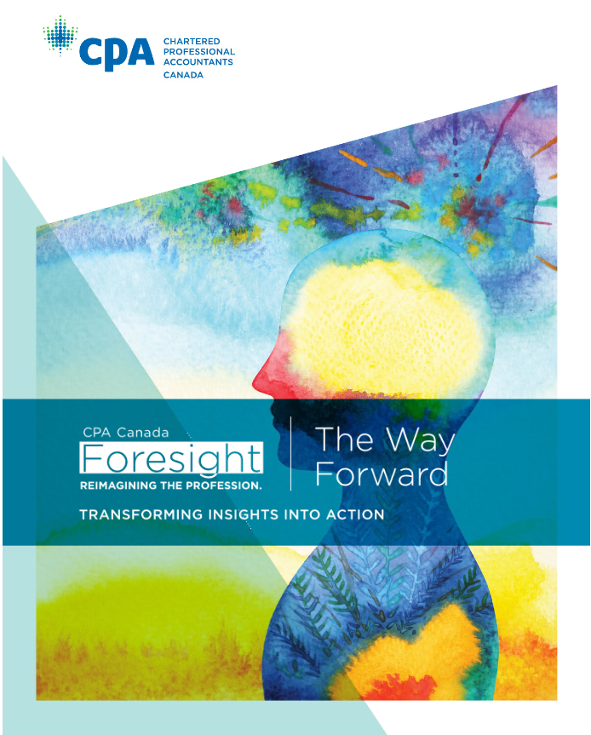
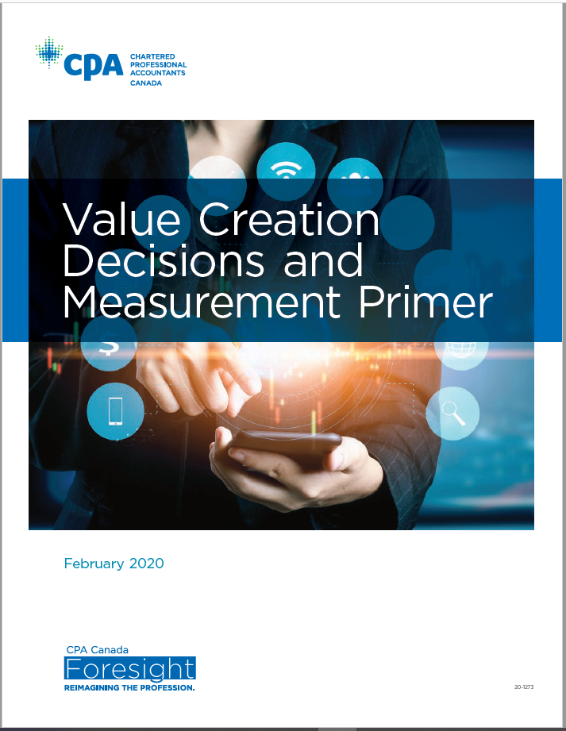
CPA Canada Foresight & Value Creation Focus
www.cpacanada.ca/en/foresight-initiative/value-creation
Notes:
Global change is accelerating at an unprecedented pace. Technological innovation, proliferation of data, and evolving societal expectations are reshaping all aspects of business environment including the expectations of and opportunities for the accounting profession.
Reliability: In the age of instantaneous information, there is eroding trust in sources of information particularly social media. What is the role of the CPA profession in building confidence in information that fuels decision-making?
Value: Accounting standards do not cover all aspects of value that have become increasingly important in business in the information age. Today, the majority of a company’s value is now reflected in intangible aspects – i.e., platforms, brand, reputation, innovation, culture, trust, corporate governance etc. - measures for which there are no rules governing their construction and disclosure. How do we identify, develop and communicate the metrics to help organizations better articulate how they create value for the long-term?
Big Data: Internet-based companies are awash with data that can be grouped and utilized. The proliferation of data and its consumption by consumers, governments and investors is putting companies at risk of losing control of their story. There is a key difference between data creation and value creation - are companies overlooking opportunities to create value? How well do organizations understand their investors and what informs their decision making? Are the key performance measures and other metrics we are reporting well suited to the fluid and digital information environment? The accounting profession plays an important role in separating noise from facts.
Business & Society: Employees are ready and willing to trust their employers, but the trust must be earned through more than “business as usual.” Institutional investors, employees, customers, communities and governments increasingly look to corporations to integrate societal issues into corporate thinking and take responsibility for the impacts of their operations on society. How do we reorient players across the investment value chain towards a longer-term, societal, multi-stakeholder perspective? How do we help companies capture a wider set of information beyond short-term financial performance and measure and report on it?

Slide 4
Investor perspectives
“Almost 60% of mutual fund assets will be ESG by 2025”
Source: pwC
97%
of investors evaluate non-financial disclosures
100%
of investors and bond rating organization buy climate-related financial data from 3rd party data providers
56%
of investors said that a company’s non-financial disclosures are either not available or inadequate for meaningful comparison with those of other companies
Sources:
EY 2018 Global Climate Change and Sustainability Services study
CPA Canada Investor Interview Report (2019)
Notes:
93% of the 250 largest corporations in the world report on ESG

Slide 5



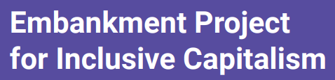




Value creation/ESG reporting solutions
Runs the global disclosure system for investors, companies, ......to manage their
environmental impacts
Committed to advancing and aligning the global mainstream corporate reporting model to equate natural capital with financial capital
SASB’s mission is to help businesses around the world identify, manage and report on the sustainability topics that matter most to their investors
We came together in pursuit of a single goal: to identify and create new metrics to measure and demonstrate long term value to financial markets
Helps businesses and governments understand and communicate their impact on critical sustainability issues
To align capital allocation and corporate behaviour to wider goals of financial stability and sustainable development through the cycle of corporate reporting and thinking
A forum for building global consensus on how to measure, report, compare and improve impact performance
The work and recommendations of the Task Force will help firms understand what financial markets want from disclosure in order to measure and respond to climate change risks and encourage firms to align their disclosures with investors needs
Notes:
In addition several convening initiatives have emerged as a response to market calls for coordination of the various instruments

Slide 6
Reporting challenges
Divide between environmental/social reporting and financial reporting
Quality and format of data (measurement, assurance gap)
Shift from periodic to real-time

Slide 7


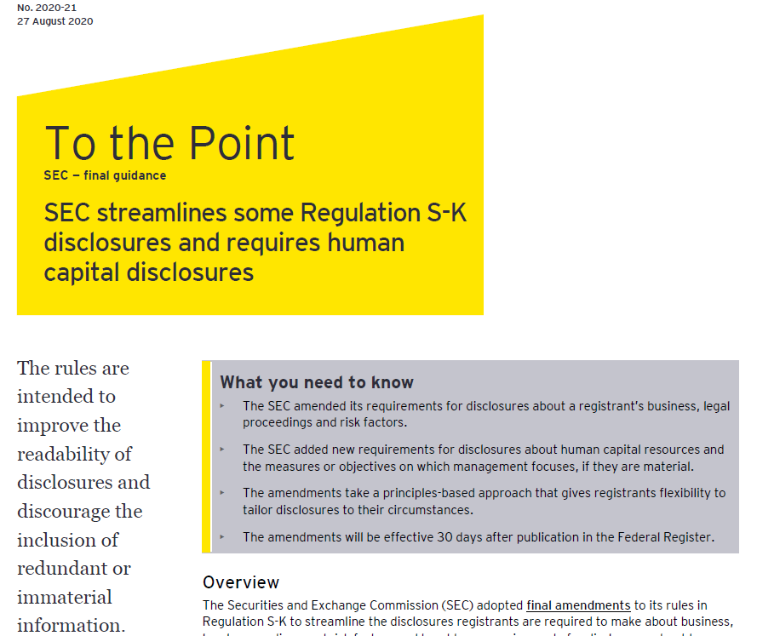
Regulatory intervention
EFRAG mandated to provide recommendations on possible EU non-financial reporting standards
Climate-reporting conditions accompany Large Employer Emergency Financing Facility (LEEFF)

Slide 8
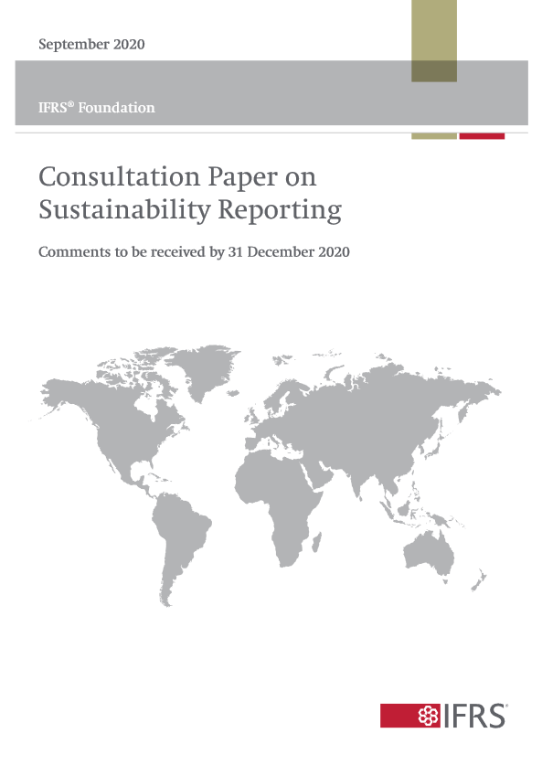
IFRS Foundation consultation
In the context of their strategy review, the Trustees have published a consultation paper on sustainability reporting to determine:
whether there is a need for global sustainability standards
whether the IFRS Foundation should play a role
what the scope of that role could be
Comments due December 31, 2020

Slide 9
The opportunity
Building on experience and success in financial reporting standard setting
The accounting profession can provide leadership in establishing high quality ESG standards that can be applied consistently
A global solution will
  bring discipline and rigor to the ESG reporting process
  improve the quality and comparability of ESG reporting for the benefit of investors
  appropriately balance costs and benefits
  Canada and the world need better ESG reporting and the accounting profession has the people and organizations to help achieve this!

Slide 10

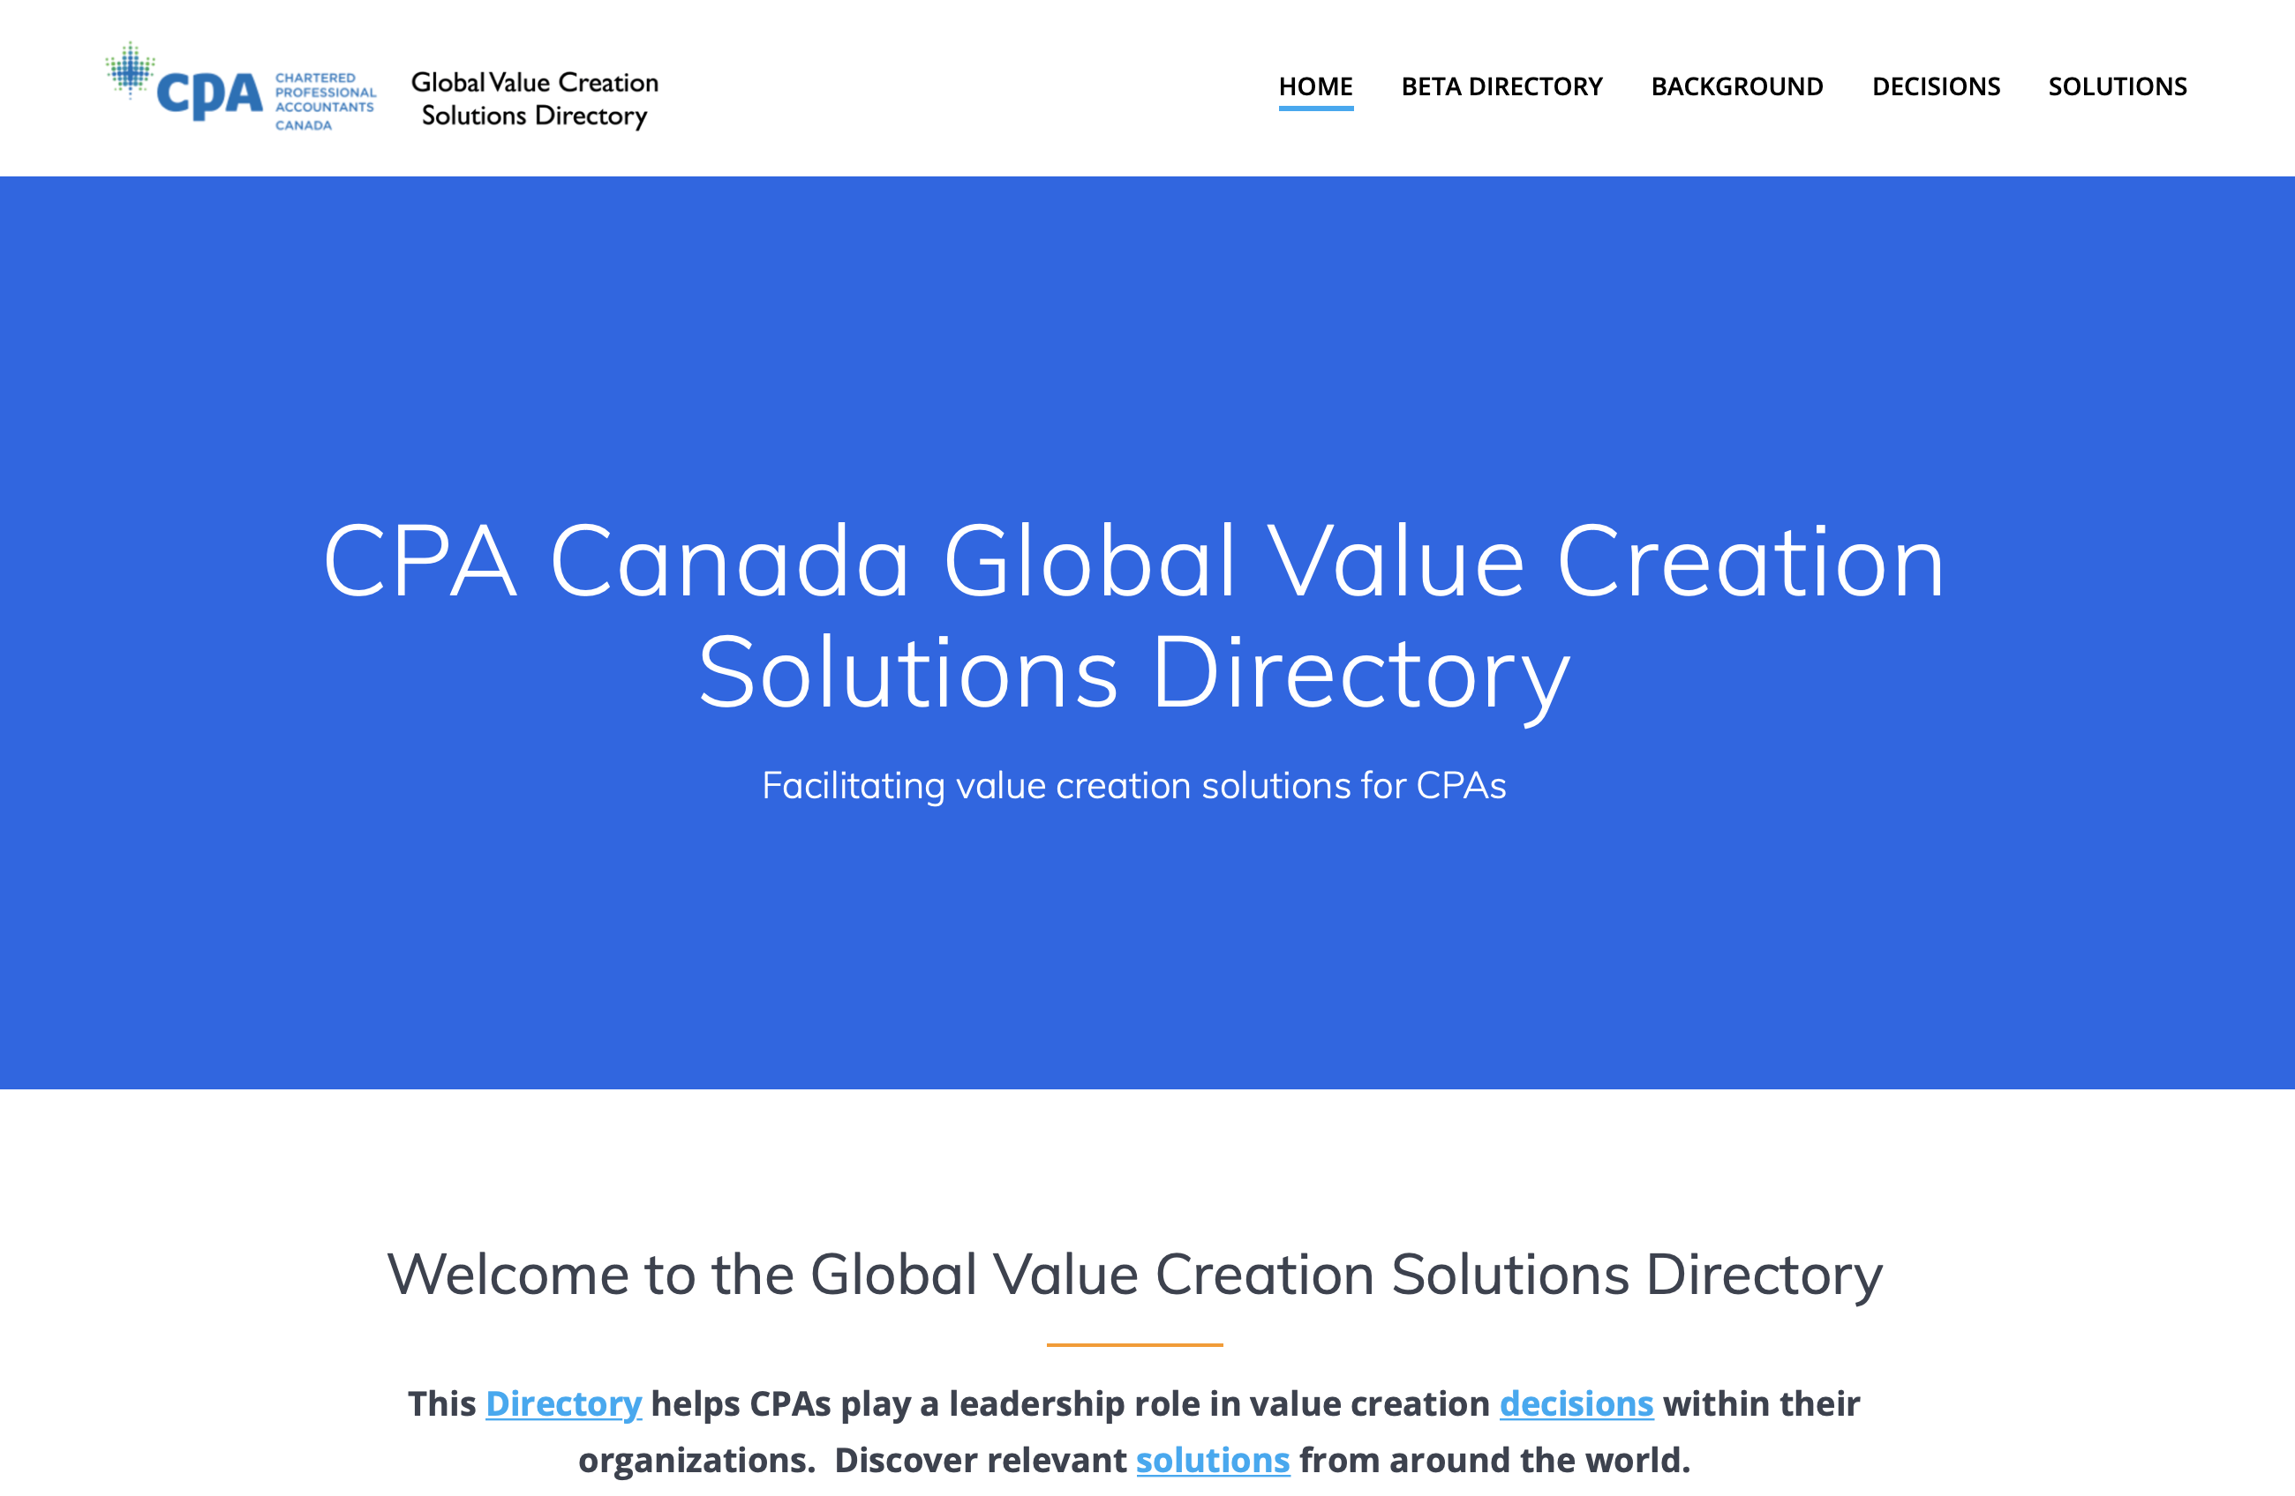
Coming soon…

Slide 11
Thank you!

