Slide 1
PAC PPTs for Day 2 2020

Slide 2

PAC ANNUAL CONFERENCE
October 22 & 23, 2020
Professional Accounting Futures
ESG Challenges Facing Professional Accountants

Slide 3
ESG Measurement & Disclosure Challenges Panel
This panel will explore the thorny issues of ESG measurement and disclosure – what to measure, how to measure, and whether and how ESG measures should be disclosed. The panel will bring broad perspectives – from preparers and data providers to standard setters, regulators, and academics.
Daniel Hicks, Miami Herbert Business School; Florida Sustainability Partners
Simon MacMahon, EVP, Head of ESG Research, Sustainalytics
Rob McLean, President, MatrixLinks
Stefan Reichelstein, Director, Mannheim Institute, Univ. of Mannheim
Moderator: Gord Richardson, Rotman School, University of Toronto

Slide 4
Daniel Hicks will present his PDF

Slide 5
PAC ANNUAL CONFERENCE
Professional Accounting Futures
October 23, 2020
The Role of Media in Sustainability (ESG) Reporting & Assurance
Daniel Hicks
Professor of Economics
Miami Herbert Business School
F

Slide 6
PAC ANNUAL CONFERENCE
Professional Accounting Futures
October 23, 2020
The Growing Importance of ESG Disclosures
and ESG Disclosure Challenges
Simon MacMahon
EVP, Head of ESG Research
Sustainalytics (a Morningstar Company)

Slide 7
PROFESSIONAL ACCOUNTING FUTURES – 2020
ESG CHALLENGES FACING PROFESSIONAL ACCOUNTANTS
ESG Measurement and Disclosure Challenges
Simon MacMahon, Head of ESG Research
Sustainalytics
October 23rd, 2020

Slide 8
Intro

Slide 9
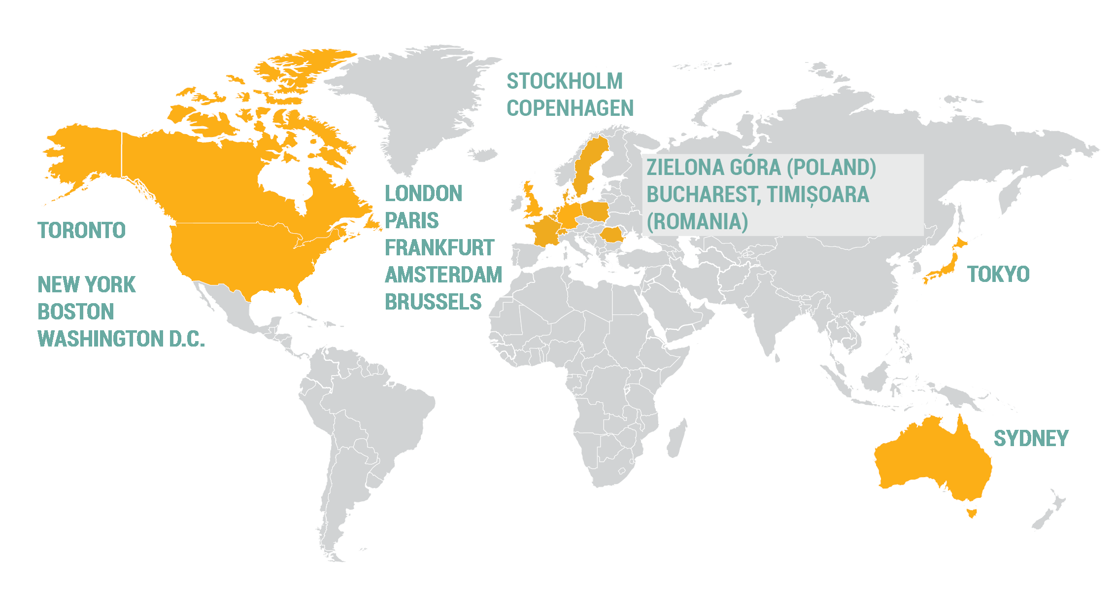
More than 25 years of ESG research solutions to global investors
One of the largest investment research and ratings firm dedicated to responsible investment and ESG research
650 professional staff with more than half engaged in research.
In excess of 700 clients across asset managers, asset owners and investment banks
Over 25 years' experience in the fields of ESG and corporate governance research.
Ownership: Became a Morningstar company in July 2020

Slide 10




Support Throughout the Investment Chain
Targeting outcomes
Our clients use our research and engagement services to target outcomes at both the portfolio and individual company level, for example setting objectives around carbon, global norms and sustainable development.
Post-investment
Active ownership
We support our clients in their engagement with investee companies across asset classes, through research and corporate engagement services, including voting services for public equities.
Reporting and monitoring
Our research is used by clients to monitor investee companies and report internally and externally on a range of metrics. We also provide portfolio reporting tools on our online research portal and through third party platforms.
Investment
Investment Selection
We help our clients identify and understand ESG risks and opportunities in their investable universe to support portfolio construction, the selection process as product creation.
ESG Integration and risk management
Our ESG Risk Ratings and other research products support investors in their fundamental analysis, risk management and during the investment decision-making process
Pre-investment

Slide 11
Sustainalytics
What We Do
We help investors integrate ESG and Corporate Governance factors into their investment processes by providing data, ratings and research to enable more informed investment decisions
ESG Integration | Compliance & Screening | Portfolio Analysis | ESG Engagement Services | Index Services
ESG Risk Ratings Corporate Governance Research & Ratings Carbon Risk Rating Country Risk & Country Screening Sustainable Products Research ESG Data | Global Standards Screening Product Involvement Controversies Research Weapons Research (Controversial Weapons Radar, Arms Trade Research) Country Involvement Human Rights Radar | Portfolio Screening ESG Portfolio Analytics Carbon Portfolio Analytics Portfolio Monitoring (Controversy Alerts, Corporate Governance Insights) | Global Standards Screening Engagement Thematic Engagement Material Risk Engagement | Index Research Services Supported Indexes

Slide 12
ESG Measurement and Disclosure

Slide 13
Sustainalytics’ ESG Research Process
A. Annual Update
B. Controversy Research: Two-Week Cycle
Corporate publications and regulatory filings
NGO reports/websites
News and other media
Company dialogue
Daily search of news sources. social media, specialized publications and non-government organizations
Focus on well-known, respected global and regional media sources
Dedicated research team
Stress & Scenario Testing
Publication of
ESG Rating Report
Daily News Screening
Daily Incident Creation
Bi-weekly Event Updates
Bi-weekly Controversy Rating Update
Company Feedback
Risk Appetite
Risk Culture
Research Process
Quality and Peer Review
Company
Data
Analysis
Media and NGO Information

Slide 14
ESG Indicator Types
Exposure Indicators
Management Indicators
Events Indicators
Product/Activity Involvement
Industry
Policies
Policies
Product Involvement (Negative)
Geographic
Programs and Management Systems
Programs and Management Systems
Solutions Involvement (Positive)
Business Model
Disclosure and Compliance Initiatives
Disclosure and Compliance Initiatives
Activity Based Research
Financial Health
Performance/ Outcomes
Performance/ Outcomes
Relevance,
Simplicity,
Efficiency,
Comparability,
Consistency,
Durability,
Unbiased,
Distributed, and
Orthogonal

Slide 15
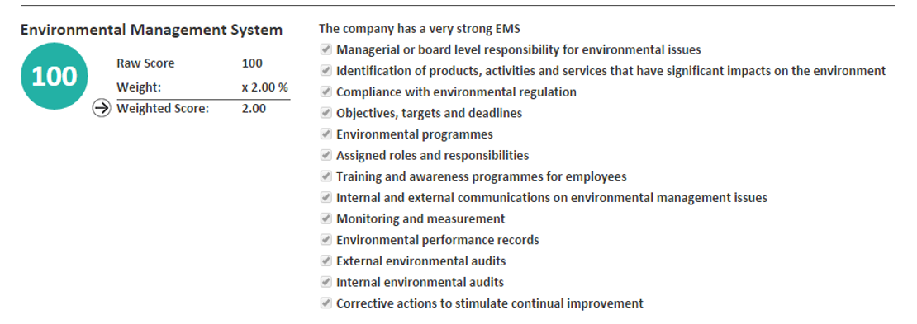
Indicators and weights
Example: Management Indicators
Answer category, e.g. “the company has a strong environmental management system”
Scoring system, e.g. a strong policy requires 7 ticked boxes
Analyst guidance that support analysts in scoring indicators consistently

Slide 16

Current Disclosure Outcomes and Challenges
We have seen ESG Disclosure Rates Rise Dramatically
  Approximately 80% of the top 4500 companies produce some form of sustainability reporting
However, Current Disclosure Practices leave a lot to be Desired
  Incomplete Disclosures
    Only 12 percent of companies report ESG disclosures according to best practice
    Average disclosure rate is only 64% across our ESG Risk Rating indicators
  Inconsistent Disclosures
    We sometimes struggle with disclosures that report according to different standards or that are difficult to normalize.
  Low Quality Disclosures
    Quantitative disclosures are sometimes of poor/questionable quality

Slide 17
The Changing Regulatory Environment

Slide 18
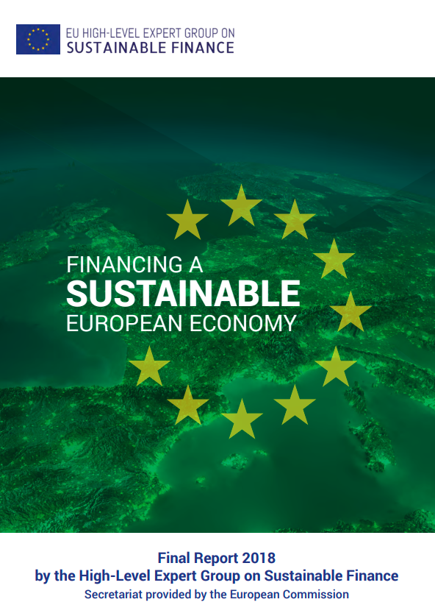
Entering a Very Dynamic Regulatory Period for ESG
Some financial market actors and regulators are questioning whether the current voluntary disclosure regime is working.
Multiple consultations ongoing that ask the question of whether new mandatory ESG disclosure regulations are needed
  EU Sustainable Finance Action Plan
  ESMA, IFRS, OSC, among others

Slide 21
PAC ANNUAL CONFERENCE
Professional Accounting Futures
October 23, 2020
Insights arising from applying measurement fundamentals to value creation solutions: implications for ESG reporting
Rob McLean
President
MatrixLinks

Slide 22
Insights arising from applying measurement fundamentals to value creation solutions:
Implications for ESG reporting
Rob McLean
MatrixLinks International Inc. and
CPA Canada
October 23, 2020

Slide 23
Insights arising from applying measurement fundamentals to value creation solutions:
implications for ESG reporting
Outline
CPA Canada’s Foresight Initiative and Value Creation focus
Defining value creation
Focus on value creation decisions and solutions, and underlying measurement approaches
Measurement fundamentals
Applying measurement fundamentals to value creation solutions: emerging insights
Opportunities for collaboration to strengthen measurement in an ESG and other contexts

Slide 24

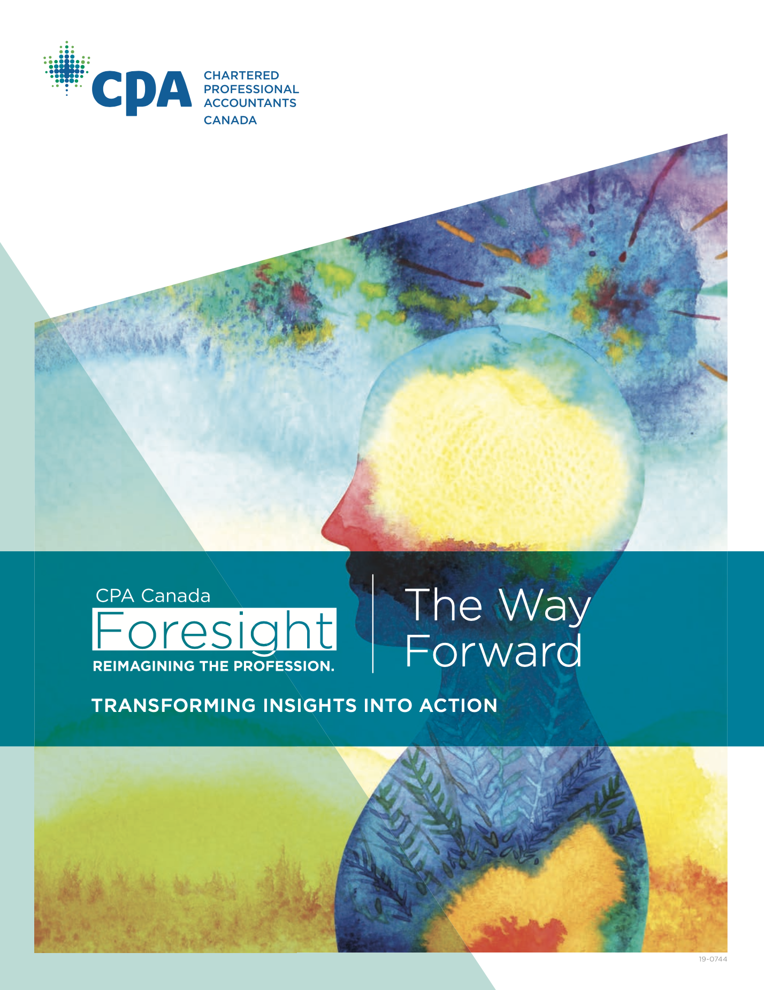
1. CPA Canada’s Foresight Initiative and Value Creation focus
Foresight: “Where to play”
Rethinking value creation, both in terms of the development of new and
evolving models of value creation and in reassessing how accountants add value.
Mastering and shaping a data-driven economy. Every CPA must ultimately
become comfortable in a world that will be data-rich, data-intense and data- driven. In concert with this, CPAs should play a role in the development of standards for data governance and data integrity.
https://www.cpacanada.ca/foresight-report/

Slide 25
2. Defining value creation
Traditional value realization
accounting and reporting
Measures previously-created value as it is realized through transactions with third parties
Value creation measurement
Measures future value creation potential (value streams) in advance of a third party transaction
Our provisional definition of value creation: “the process by which an organization creates the potential for:
a) revenue and net income that can be realized in the future, and/or
b) future benefits for the organization’s stakeholders”

Slide 26
Value Streams Thinking
Value Creation Life Cycle
Future Value
Streams
Value Streams
Focus
Realized Value
Financial and non-financial
Organization and stakeholders
Transactions
Traditional
accounting
Focus
“What is the value potential the enterprise can create in the future, and how well is it performing in making that potential realizable?”
“How well did the enterprise perform in the most recent fiscal period?”

Slide 27
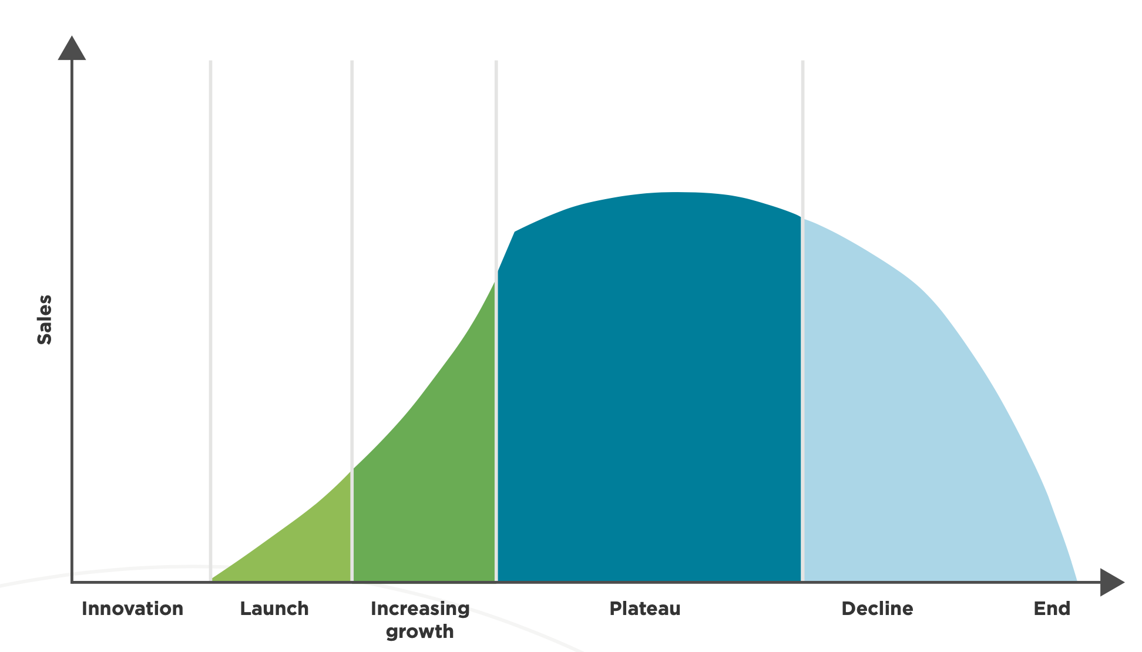
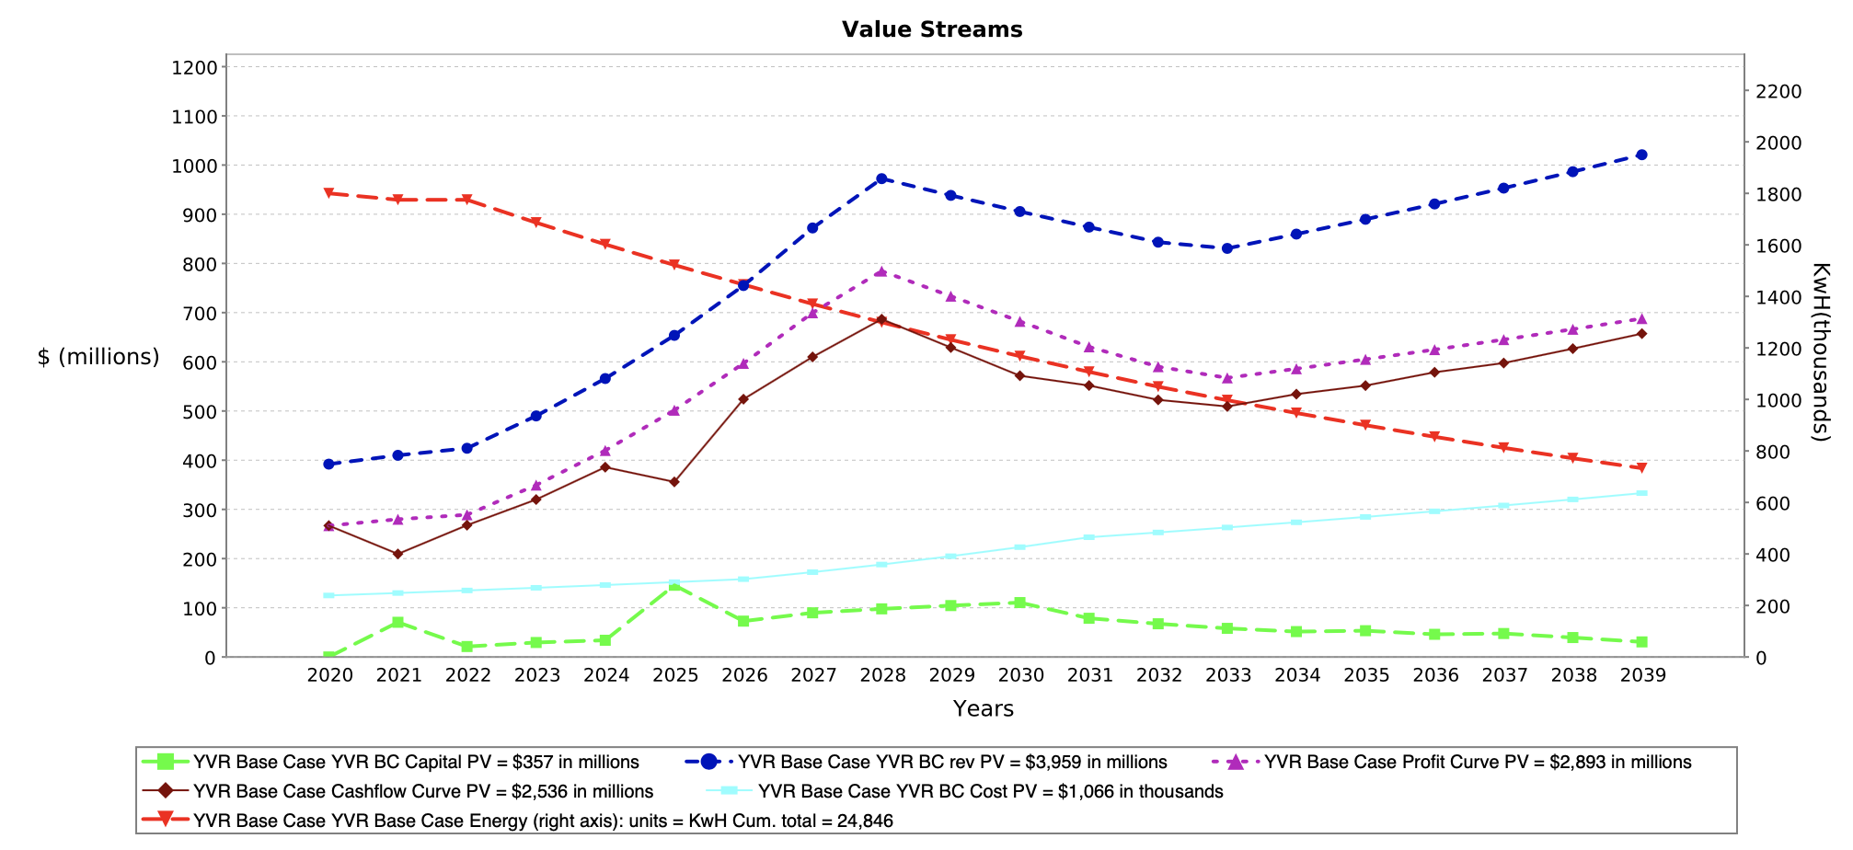
Modelling value streams

Slide 28
Value Creation Continuum
Narrower
Broader
From the perspective of the organization itself
From the perspective of all stakeholders. (This brings in sustainability and social impact)
From the perspective of investors and capital markets

Slide 29
3. Focus on value creation decisions and solutions (versus reporting / disclosure)

Slide 30
Focus on value creation decisions and solutions
CPA Canada initial value creation priority is helping CPAs play leadership roles in forward-looking value-creation-related decisions in the organizations they work with
All decisions involve choices among alternatives
Good decisions require good information
Decisions should be supported by measures that clarify the consequences of alternative decisions, at the highest level of precision that is practicable
CPAs are at core, measurement professionals
Our challenge and opportunity is to help CPAs expand their recognized skillset beyond measuring financial performance to include all aspects of measurement relevant to value creation decisions

Slide 31

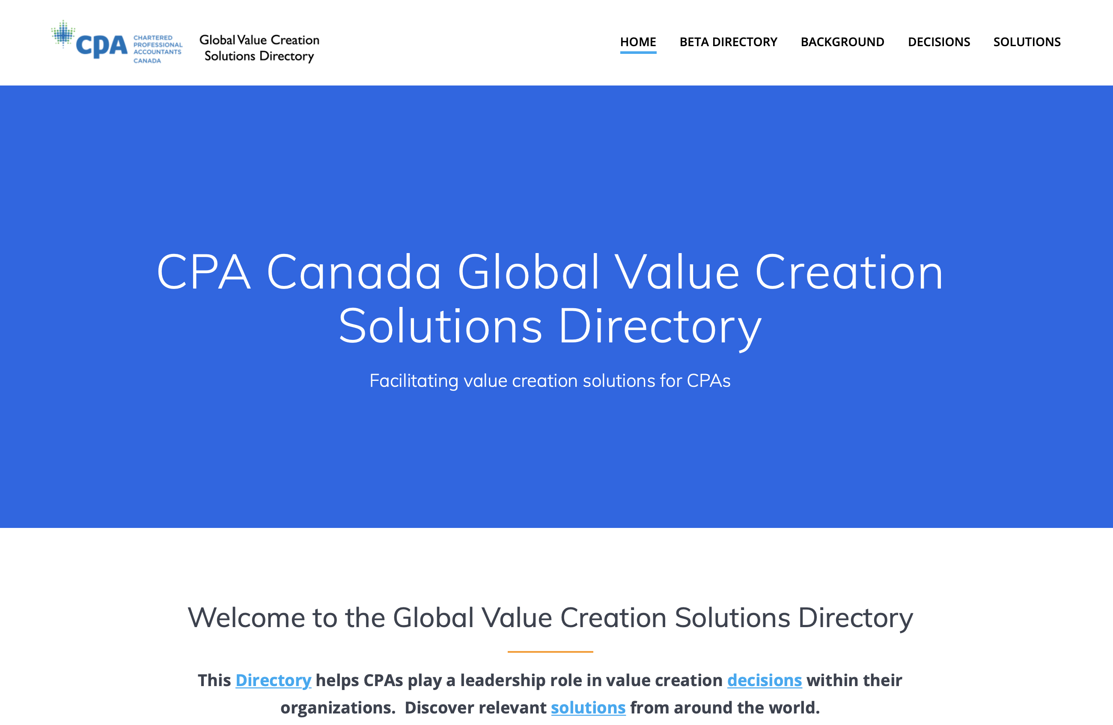
Focus on value creation decisions and solutions

Slide 32
Value Creation Solutions Measurement Analysis
Implementation requires quantitative measurement | 75%
Proponent provides guidance on what to measure | 68%
Proponent provides technical guidance on valid measurement | <10%

Slide 33
Value Creation Solutions Measurement Analysis
Principal measurement categories
1. Intangibles / Intellectual Capital / Data
2. The Capitals
3. Indicators / Metrics
4. Monetized impacts
5. Future value streams and events

Slide 34
4. Measurement fundamentals
“Measurement fundamentals” refers to the principles that underlie valid measures. Measurement approaches that violate these principles can be misleading, incomplete, inaccurate, and lead to conclusions and decisions that differ from those that would be reached based on valid and precise measures
• What are the key ingredients for valid measurement?
  Like objects of measurement (e.g. apples to apples)
  Like properties of measurement (e.g. quantity versus roundness versus cost, etc.)
  Like unit of measure (quantity, currency, etc.)
  Like precision based on the scale (e.g. nominal, ordinal, interval, ratio)
  Commensurability: when can I validly add or subtract one measure from another?
  Measurement fundamentals are “baked in” to the traditional transaction-centric accounting paradigm, but need to be specifically considered outside that paradigm

Slide 35
5. Applying measurement fundamentals to value creation solutions: emerging insights
The transaction-centric accounting paradigm
Many people assume that accounting measures assets and liabilities, but this is incorrect.
The principal object that traditional accounting measures is a transaction
The property measured is transaction value (which could be counted as revenue or cost)
The unit of measure is currency as of the date of the transaction
The scale and precision for currency is ratio
The fact that traditional accounting measures are based on third-party transactions is arguably one of its greatest strengths as well as its most important inherent limitation, if what we want to measure cannot be measured using a transaction (such as value creation in advance of its realization through a transaction)

Slide 36
Intangibles
Applying measurement fundamentals to value creation solutions: emerging insights
Intangibles that arise from a transaction, and self-generated intangibles that meet specific criteria may appear on balance sheets measured at cost (or less if value impaired)
For most intangibles the concept of market or fair value doesn’t apply for three main reasons:
  Many intangibles are non-tradeable (company culture, reputation, etc.)
  Even for tradeable intangibles (e.g. patents, data), comparable market values rarely exist
  For most intangibles, the value streams they can generate depends on context, and most have limited value outside a relevant context. To illustrate, the value Patent A can generate for Company B differs from that it could generate for Company C depending on each company’s “complementary business assets”. Patent A on its own has very limited value.
The value concept that does work for intangibles is “incremental value-in-use” based on the extent to which an intangible contributes to future value streams in the company context(s)
Advocacy efforts promoting better disclosure of intangibles should focus on supplementary information about intangibles, including cost and incremental value-in-use

Slide 37
The Capitals
Applying measurement fundamentals to value creation solutions: emerging insights
With the exception of financial capital (for which the underlying object is transactions), the other capitals (which depending on the specific framework may include manufactured, intellectual, human, social and relationship, and natural) are constructs, not objects that can be measured
If these constructs are disaggregated sufficiently to become measurable, the underlying objects, properties, and units of measure are diverse and not commensurable. So while thinking about the stocks of capitals works as a conceptual analogy and supports value creation from a process perspective, it is not technically possible to measure the value of stocks of non-financial capitals in a valid way
As a result, quantitative measures related to the capitals are usually expressed as metrics or indicators
From a value measurement perspective, it may be easier to quantify many of the underlying components of the capitals as flows (aka value streams) than stocks

Slide 38
Metrics and Indicators Frameworks (including ESG frameworks)
5. Applying measurement fundamentals to value creation solutions: emerging insights
There are two principal technical measurement challenges that arise related to any framework of metrics or indicators
  Given that a framework is necessarily selective and arbitrary based on the chosen metrics or indicators, how can we know that the framework “faithfully represents” the underlying reality?
  How does a user achieve a “holistic perspective” on value or performance from a framework of metrics or indicators? In accounting, comparing composite values such as net income, net assets, and net cash flow provides a holistic perspective on overall financial performance, and whether overall financial performance is getting better or worse over time. How does one achieve a similar overall understanding from a metrics or indicators framework?
There is a tension between these factors: more comprehensive and complex frameworks are more likely to better reflect the underlying reality, but the more comprehensive and complex the framework, the more difficult it is for a user to achieve a holistic overall perspective on that underlying reality

Slide 39
Monetizing impacts
Applying measurement fundamentals to value creation solutions: emerging insights
Monetizing impacts typically involves a string of measures, assumptions and conversions to represent ecosystem or social impacts in units of currency. For the end result to be valid in relation to measurement fundamentals, each step in the process must be valid.
How precise can monetized impacts be? For instance, if monetizing impacts were to involve a string of 5 calculations, a +/-10% error at each stage could result in a cumulative error of more than 100%.
In many cases, the resulting level of precision can be better expressed as a range estimate than a point estimate
Attempts to add or subtract transaction-based values and impact-based values creates a commensurability issue, since these are different measurement objects
Will the resulting values be sufficiently valid so as to be reliable for decision-making purposes? How do we ensure that users can have sufficient and justified confidence in the results so as to be able to use them for decision-making purposes?

Slide 40
Future value streams and events
5. Applying measurement fundamentals to value creation solutions: emerging insights
The concept of “event-based value streams” was developed as a methodology for measuring value creation, analogous to the way value realization is measured using transactions. Value streams can be financial and non-financial, and measured from the perspective of the organization and stakeholders
Modelling future value streams involves inherent uncertainty. (As the famous catcher Yogi Berra said, “It's tough to make predictions, especially about the future.”)
Methods to deal with this uncertainty include:
    Linking assumptions to events
    Full disclosure of assumptions and events
    Enabling users to view the results of substituting their own assumptions and events
    Sensitivity analysis
    Exploring alternative scenarios
    Tracking the ratio of past and future events influencing a model
    Attaching probability distributions to events and scenarios
  While financial value streams can be aggregated, developing a holistic perspective on multiple non-financial value streams remains a challenge, similar to that discussed above related to metrics and indicators frameworks

Slide 41
6. Opportunities for collaboration to strengthen measurement in ESG and other contexts
CPA Canada is eager to collaborate with proponents of value creation solutions and measurement approaches to enhance validity and precision to support decision-makers
ESG
Developing criteria for testing the degree to which ESG metrics or indicators frameworks are valid representations of underlying reality
Exploring ways to enhance users’ ability to obtain a holistic perspective from a ESG metrics or indicators framework
Developing methods for testing that monetized impacts are sufficiently valid and precise to support decisions
Other
Working toward generally-accepted methods for modelling incremental value-in-use for various types of intangibles
Exploring the potential to measure components of the capitals as flows / value streams
Working toward generally-accepted methods for modelling event-based value streams

Slide 42

Insights arising from applying measurement fundamentals to value creation solutions:
implications for ESG reporting
Thanks for listening, and we look forward to the ongoing discussion today, and in and the future
CPA Canada’s work on value creation is continuing, including forthcoming publications on measurement, data value, the Global Value Creation Solutions Directory, as well as additional future initiatives. Stay tuned!

Slide 43
PAC ANNUAL CONFERENCE
Professional Accounting Futures
October 23, 2020
Corporate Carbon Emission Disclosures
Stefan Reichelstein
Director, Mannheim Institute for Sustainable Energy Studies,
University of Mannheim
William R. Timken Professor Emeritus,
Stanford Graduate School of Business
Senior Fellow, Precourt Institute for Energy

Slide 44
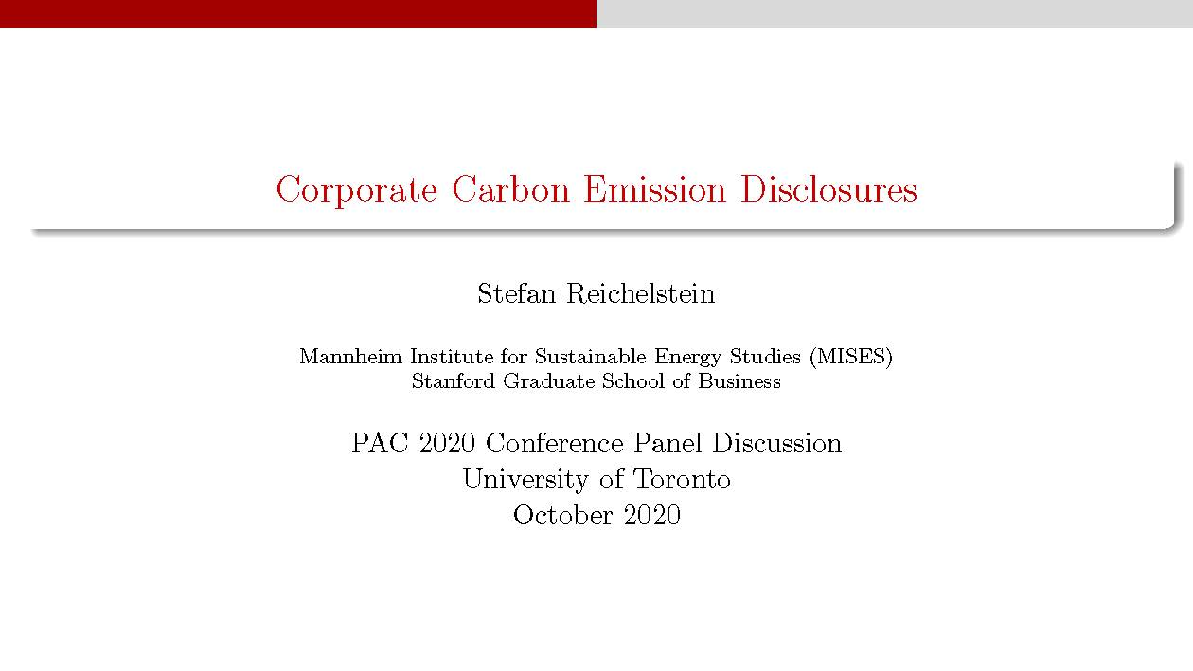

Slide 45
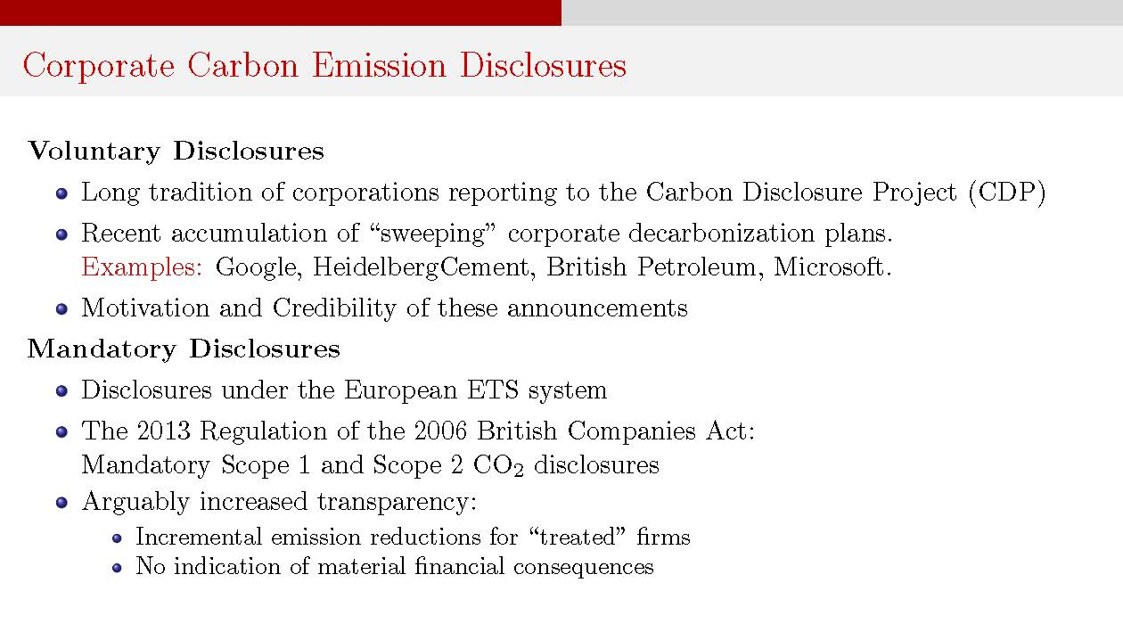

Slide 46
PAC ANNUAL CONFERENCE
Professional Accounting Futures
October 23, 2020
Unifying Comments
Gordon Richardson
KPMG Professor of Accounting
Rotman School of Management, University of Toronto

Slide 47
PAC ANNUAL CONFERENCE
Professional Accounting Futures
October 23, 2020
Questions & Answers

Slide 48
PAC ANNUAL CONFERENCE
Professional Accounting Futures
October 23, 2020
Break

Slide 49
ESG Investing:
Making Sense of Measurements and Disclosure
This panel will explore the rise of ESG-based investing, its current status, potential pitfalls, and the way forward. Among other things, the panel will discuss the types of metrics investors use to evaluate ESG, and the weights that they place on ESG metrics vs. financial and operational metrics.
Dominique Barker, Head, Sustainability Advisory, CIBC Capital Markets
Elizabeth White, Global Head of Strategy-ESG Sustainability, International Finance Corp. (World Bank)
Carson Block, Chief Investment Officer, Muddy Waters Capital Inc.
Shiva Rajgopal, Roy Bernard Kester and T.W. Byrnes Professor, Columbia University
Anthony Scilipoti, CEO, Veritas Investment Research

Slide 50
PAC ANNUAL CONFERENCE
Professional Accounting Futures
October 23, 2020
ESG Investing: Making Sense of Measurements and Disclosure
Dominique Barker, CFA
Head, Sustainability Advisory
Global Investment Banking
CIBC Capital Markets

Slide 51
PAC ANNUAL CONFERENCE
Professional Accounting Futures
October 23, 2020
ESG and Impact Investing Taking AIMM
Elizabeth White
Global Head of Strategy, ESG Sustainability
International Finance Corporation (World Bank)

Slide 52

ESG and
Impact Investing Taking AIMM

Slide 53
ESG and Impact Investing
Most Impact Investors will screen for, and manage, ESG risk as part of their investment practices
Originate
Deploy
Manage
Exit
Thesis: Business Strategy, Financial Potential
Negative Screen to
Filter based on do no harm, ES risk and CG practice
Use scorecards to understand company performance, minimum threshold
Deploy through public markets
Use ownership position to suggest ESG performance improvements
Regularly report on ESG performance
Sells shares and redeploy proceeds as desired. Compare performance in ESG vs non ESG investment
No required reporting on change in impact performance
ESG
Thesis: Intention to contribute to solutions for societal changes
Investments align with intention and serve markets
Use systematic impact alignment assessments to identify and source investments
Deploy through private markets
Actively seek ways to deepen positive impacts for all stakeholders, address negative
Report on outputs and outcomes where possible, using standard metrics
Conduct exits considering effect on sustained impact
Publicly disclosure
Impact Investing
The difference between ESG and Impact Investing, Neil Gregory; Kusi Hornberger
Notes:
Despite these commonalities and the fact that many advisors lump ESG and impact strategies into a broader bucket of ‘sustainable’ investments, there are three requirements of investors to ensure their investments are impact investments and not ESG: 1) selection of assets with intent for impact, 2) a contribution to the impact of the investee firm, and 3) objective measurement of that impact.
ESG factors are also essential to financiers and investors in their selection and management of borrowers and investees. Investor approaches vary and have evolved substantially over the last 20 years. Confusion abounds regarding the terms to describe the varying practices, which are not mutually exclusive:
Responsible investment originated as a practice in which certain sectors perceived to be contrary to the public welfare—such as tobacco and arms—were excluded from portfolios.
ESG investment is a more recent approach that involves the systematic integration of ESG risk management and performance improvement in investee selection and
management. This can include both asset selection and engagement with investees.
• Impact investing is the selection of investments and assets whose operations have a measurable positive impact for society or the environment—alongside financial returns. These can be thematic—such as climate or gender—and typically require inclusion of ESG criteria into investment selection.

Slide 54
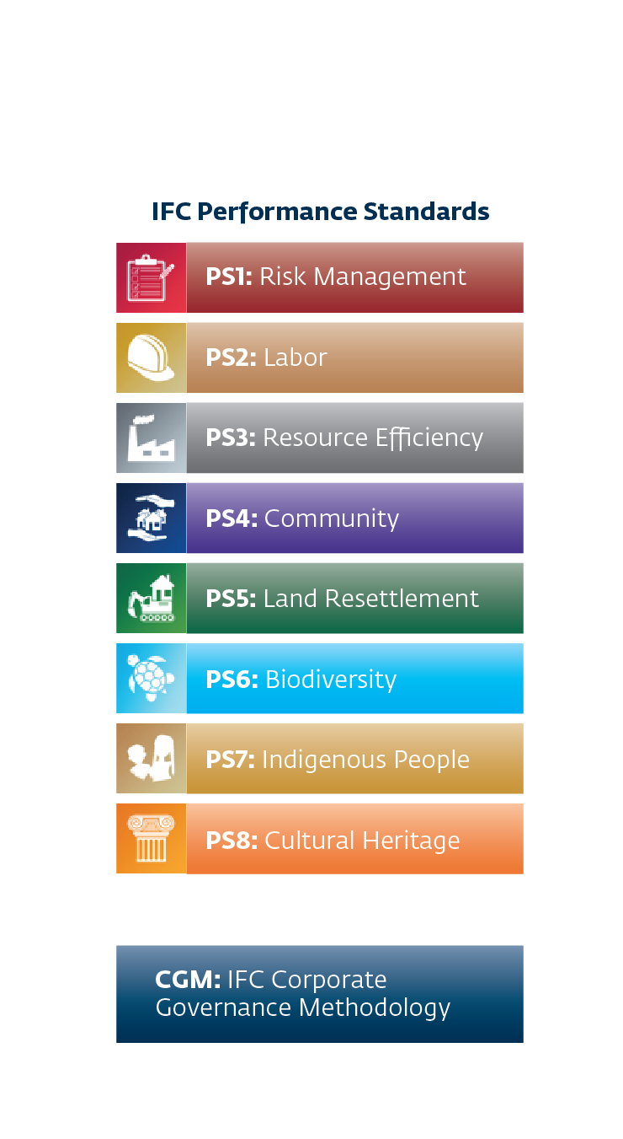
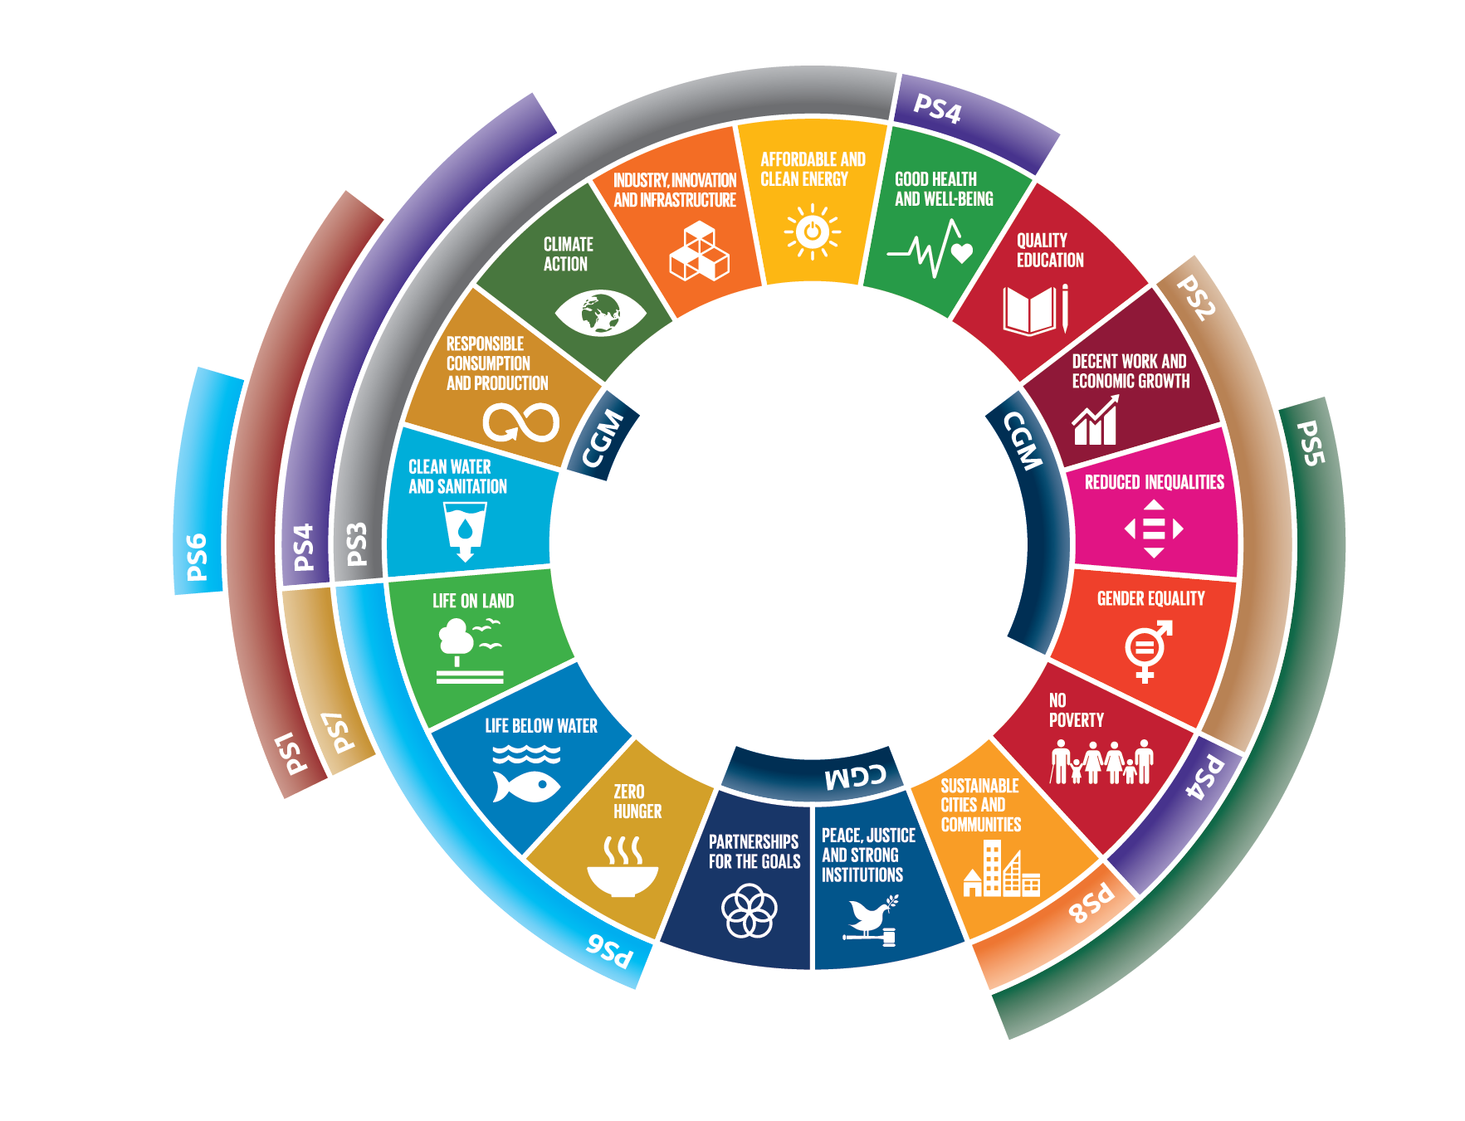
ESG is at the Core of Our Business Model
IFC’s Performance Standards & Corporate Governance Methodology Help Address 16 of the 17 Sustainable Development Goals (SDGs)
Notes:
Note: The only SDG that the Performance Standards or CG Methodology do not help address is SDG#4: Quality Education. (Red icon, upper right quadrant).

Slide 55
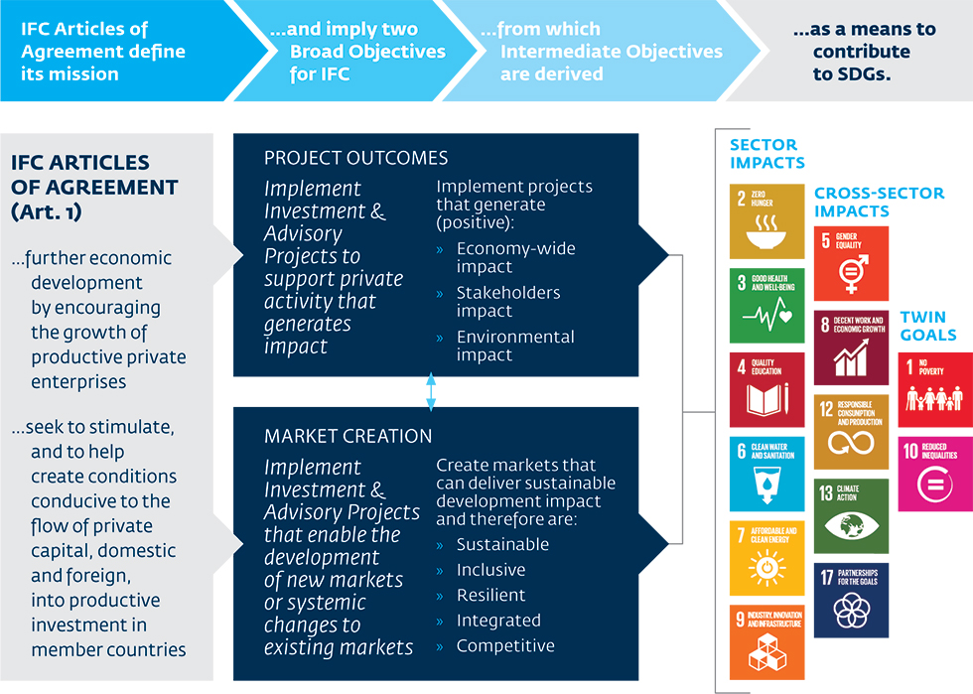
We also build on that to drive to our Mission and Goals
Brings together ESG due diligence and Impact Investing
Notes:
Despite these commonalities and the fact that many advisors lump ESG and impact strategies into a broader bucket of ‘sustainable’ investments, there are three requirements of investors to ensure their investments are impact investments and not ESG: 1) selection of assets with intent for impact, 2) a contribution to the impact of the investee firm, and 3) objective measurement of that impact.

Slide 56

Our Impact Investing Model Recognizes that ESG Matters
Delivered through an Anticipated Impact Measurement and Monitoring System
Project Outcomes
Stakeholder effects
Economy wide effects
Environmental and social effects
Rating
Excellent (68 – 100 pts)
Good (43 – 67 pts)
Satisfactory (23 – 42 pts)
Low (10 – 22 pts)
PROJECT
Competitiveness
Resilience
Integration
Inclusiveness
Sustainability
Contribution to market creation
Notes:
What is the Anticipated Impact Measurement and Monitoring (AIMM) System?
A tool to measure the development impact of IFC projects
A monitoring system to tie impact claims with actual results
A framework that provides the analytical backbone linking IFC projects with its creating markets (IFC 3.0) strategy

Slide 57
So what?
It matters for business to be able to integrate values of ESG and impacts into their decisions.
Accounting is essential;.
Enterprise Value
Social capital
Human capital
Natural capital
Impact Claims and Data to Substantiate it
Traditional financial accounting and
auditing of ESG
plus
PRICE
VALUE

Slide 58
ESG and
Impact Investing Taking AIMM

Slide 59
PAC ANNUAL CONFERENCE
Professional Accounting Futures
October 23, 2020
Short sellers’ perspective
Carson Block
Chief Investment Officer
Muddy Waters Capital LLC

Slide 60
PAC ANNUAL CONFERENCE
Professional Accounting Futures
October 23, 2020
Five Myths Related to ESG
Shiva Rajgopal
Roy Bernard Kester
and
T.W. Byrnes Professor of Accounting and Auditing
Columbia Business School

Slide 61
Five myths related to ESG
Prof. Shiva Rajgopal
2020
Notes:
.

Slide 62
ESG investing creates alpha
Myth #1: ESG investing is abnormally profitable in terms of stock returns
  An ESG heavy portfolio is typically long on tech and short on energy
  Tech has done very well in the stock markets but energy has suffered
  Tech also gets systematically higher ESG scores than energy
  Hence, ESG outperformance is simply tech outperforming energy stocks
https://www.forbes.com/sites/shivaramrajgopal/2020/05/21/how-is-esg-performing-in-the-covid-19-crisis/#2b1dcde34b62

Slide 63
WEF ESG scorecards capture variables that link to performance
Myth #2: Davos indicators of E&S are robustly related to operating performance and returns
  A bit mixed re: Green House Gas (GHG) emissions. GHG can tell us about the firm’s productive efficiency but I am not sure about regulator imposed GHG costs or “peak-oil” type arguments
  The levels related to gender gap pay and % women in management are appalling
  However, not much of a link between such measures and future performance
  Value or “values”?

Slide 64
WEF ESG measures are comprehensive
Myth #3: Davos measures are comprehensive
  Davos measures are heavy on “E” and “labor-S”
  They stay away from G raising worries about managerial capture of power
  They are somewhat silent about social return to the taxpayer
  Regulatory lobbying disclosures are scant
  State awards, subsidies, grants and payoffs in terms of jobs, taxes paid not fully disclosed in financial statements
  Selective disclosures on lawsuits and regulatory violations. Remarkably, its hard to get such data in Europe.
  https://www.forbes.com/sites/shivaramrajgopal/2020/04/16/rated-s-corporate-handouts-should-be-part-of-the-esg-scorecard/#6b5fce07279d
  https://www.forbes.com/sites/shivaramrajgopal/2020/04/24/why-dont-esg-investors-ask-for-a-public-firms-tax-return/#10e02a732cf8

Slide 65
EU corporatism and BRT signing
Myth #4: Europe has the ESG thing figured out and we ought to look to them to import those ideas
  Europe has better E and S-labor reporting
  When U.S. firms report E and S-labor, they are as good/bad as Europe
  Europe (not UK) is dominated by block holders (25% or more held by one owner)
  Hence, European stock valuations are much smaller than their U.S. counterparts
  https://www.marketwatch.com/story/a-year-after-the-business-roundtable-stakeholder-capitalism-letter-europes-record-proves-the-strategy-doesnt-deliver-11598474910
Myth #5: The Business Roundtable Statement (BRT) is a big milestone in stakeholder capitalism in the U.S.
  BRT signatories systematically have worse environmental, labor and lobbying records than very similar firms that did not sign the BRT statement
  https://www.wsj.com/articles/is-there-real-virtue-behind-the-business-roundtables-signaling-11575330172

Slide 66
PAC ANNUAL CONFERENCE
Professional Accounting Futures
October 23, 2020
Analyst view
Anthony Scilipoti
CEO
Veritas Investment Research

Slide 67
Some Truths About ESG Investing:
Measurement & Disclosure
PAC Conference
October 23, 2020
Anthony Scilipoti, FCPA, FCA, CPA (Illinois)
President & CEO
67
Notes:
YoY national real estate market appears to be rebounding and returning back to growth trends

Slide 68
The Truth About Veritas
SEEKING Truth from Facts
Forensic-Based Research Approach
Investor Advocacy
Hosting Events & Conferences
Due Diligence; Public & Private Companies
Independent Research; CDN Companies
Training and Knowledge Centre
Active Asset Management
EMPOWERING
Informed Decisions
MAXIMIZING
Impact of Capital
BUILDING Trust through Integrity
What we do. Why we do it. How we Make a Difference.

Slide 69
Differentiated: The Forensic-Based Approach
A
Analysts
Fact
A
Underwriters
A
Fact
Auditor
A
Experts
Fact
Fact
Story

Slide 70
Key Issues
Measurement
Auditability
Relevance
70
Notes:
YoY national real estate market appears to be rebounding and returning back to growth trends

Slide 71
Measurement
E-nvironmental
S-ocial
G-overnance
Quantitative/Qualitative
How?
What?
Already discrepancies are wide
71
Notes:
YoY national real estate market appears to be rebounding and returning back to growth trends

Slide 72
Auditability
Think Non-GAAP?
Think Independence?
Think Standardization?
Think Liability?
I think we are a long way off
72
Notes:
YoY national real estate market appears to be rebounding and returning back to growth trends

Slide 73
Relevance
Investment Mandate
+
Sustainable Mandate
=
Success?
How do we measure succes?
73
Notes:
YoY national real estate market appears to be rebounding and returning back to growth trends

Slide 74
Our Quality Rating
Accounting & Disclosure
Cash Flow Sustainability
Balance Sheet Risk
Business Operation Risks
Corporate Governance
Rank each
out of 5
With nearly 20 years of historical data
74
Notes:
YoY national real estate market appears to be rebounding and returning back to growth trends

Slide 75
Questions

Slide 76
Veritas Investment Research Corporation ("Veritas") its directors, officers, employees and their immediate families are prohibited from trading any position in the securities profiled in a report thirty (30) days before and five (5) days after the publication date where the report involves coverage initiation or a change of opinion (the “Blackout Restriction”). Veritas has not offered any consulting, financial advisory, investment banking or underwriting services to the companies mentioned. Veritas does not accept research fees from the companies profiled herein. The information contained in this report has been obtained from sources believed reliable however the accuracy and/or completeness of the information is not guaranteed by Veritas, nor does Veritas assume any responsibility or liability whatsoever. All opinions expressed are subject to change without notification. This report is for information purposes only and does not constitute and should in no way be construed as a solicitation to buy or sell any of the securities mentioned herein. The contents of this research report do not, in any way, purport to include any manner of legal advice or opinion. The intention of this report is to provide a forthright discussion of business, accounting and financial reporting issues, as well as generally accepted accounting principles and the limits of their usefulness to investors. As such, please do not infer from this report that the accounting policies of any company mentioned herein are not allowed within the broad range of generally accepted accounting principles, or that the policies employed by that company were not approved by its auditor(s). Veritas Asset Management Inc. (“VAM”), an affiliate of Veritas by virtue of being under common control that may also from time to time have certain common directors, officers and/or employees, is registered in Ontario as a Portfolio Manager, Investment Fund Manager and Exempt Market Dealer (with the same or similar registrations in certain other jurisdictions in Canada) and may, from time to time, advise and counsel its investment clients, including one or more investment funds established by VAM, with respect to investments in public companies. VAM is a client of Veritas and receives research reports from Veritas at the same time as Veritas’ other clients. Like Veritas’ other clients, neither VAM nor its investment clients are subject to the Blackout Restriction. Veritas and VAM have implemented policies and procedures to minimize the potential for and to address conflicts of interest, which are available to clients of Veritas upon request. This report may not be reproduced in whole or in part without the express prior written consent of Veritas. Veritas is a 100% employee owned firm. ©2018 Veritas Investment Research Corporation.

Slide 77
ANTHONY’S pptS TO FOLLOW

Slide 78
PAC ANNUAL CONFERENCE
Professional Accounting Futures
October 23, 2020
Questions & Answers

Slide 79
PAC ANNUAL CONFERENCE
Professional Accounting Futures
October 23, 2020
Getting from Learning to Doing: Insights for Practice from My (and Others’) Academic Research on Sustainability
Professor Naomi Soderstrom, FASSA,
University of Melbourne

Slide 80
Naomi Will control her slides

Slide 81

Getting from Learning to Doing: Insights for Practice from My
(and Others’) Academic Research on Sustainability
Naomi Soderstrom, FASSA
  University of Melbourne

Slide 82


Sustainability Research Themes
Decision
Measurement
Reporting
Monitoring
Decision Making

Slide 83


Sustainability Research
Measurement
We are Facing Measurement Overload!
131 pages
> 50 items / subunit
What are the “right” measures?

Slide 84
Sustainability Research
Measurement
Issue: What is Climate Risk?
Berkman, Jona, and Soderstrom “Measurement and Market Valuation of Climate Risk” WP 2020
Climate risk is forward-looking, but is frequently measured by carbon emissions, which do not fully represent climate risk
Our climate risk measure is based on 10-K disclosures, using a large dictionary
Our measure does a better job than emissions of explaining how the market values climate risk through lower valuations, higher cost of capital, and higher financial risk
Compared to emissions-based measures, our measure is also better at explaining market response to severe weather events that increase the salience of climate risks to investors

Slide 85
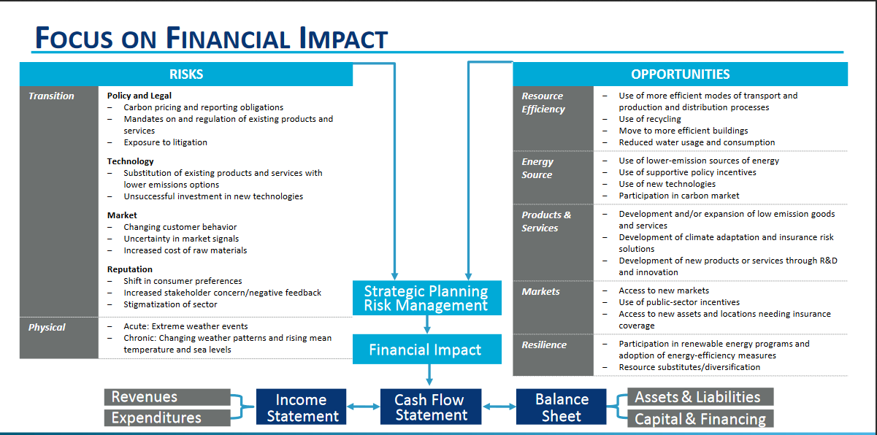
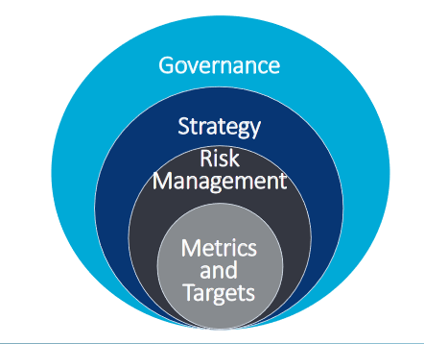
Sustainability Research
Measurement
Issue: What is Climate Risk?
TCFD
Insights: Be careful to have the right measure, or at least understand what you are measuring.

Slide 86
Sustainability Research
Measurement
Issue: How do we deal with having so many measures?
Ilinitch A., Thomas, T., and Soderstrom, N. “Measuring Corporate Environmental Performance.” Journal of Accounting and Public Policy. 17(4,5): 383-409. 1998.
A growing number of organizations offer to help decision-makers understand sustainability performance by coming up with some sort of index or ranking.
Many of these are “black boxes”, which makes it difficult to appropriately use the measures.
We examined two Environmental Performance rating systems: Franklin Fund and Council on Economic Priorities
Neither group provided information on how the ratings were derived. We find that FF focused on compliance, CEP focused on environmental impacts. Both ratings were heavily impacted when the company had a stain on its environmental record.

Slide 87
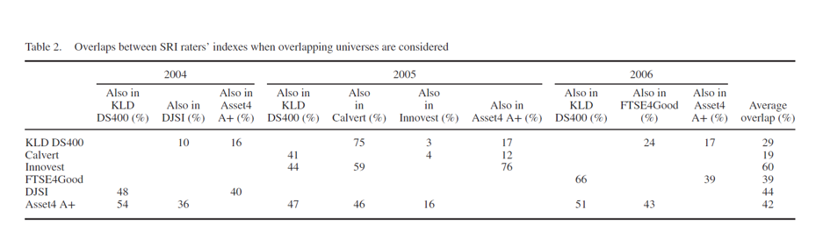
Sustainability Research
Measurement
Issue: How do we deal with having so many measures?
This finding continues—the same data are interpreted differently by different raters
Chatterji, A., Durand, R., Levine, D., and Touboul, S. “Do ratings of firms converge? Implications for managers, investors, and strategy researchers” Strategic Management Journal 37: 1597-1614. 2016
Insights: Although aggregating measures can make them easier to use, we need to understand what they are measuring.

Slide 88
Sustainability Research
Reporting
Issue: Should disclosures be mandatory?
Berkman, Jona, and Soderstrom “Measurement and Market Valuation of Climate Risk” WP 2020 revisited
Climate risk disclosures in 10-K’s became meaningful after SEC guidance was issued and the number of firms disclosing increased dramatically.
Other evidence:
Christensen, H., Floyd, E., Liu, L., and Maffett, M. “The real effects of mandated information on social responsibility in financial reports: Evidence from mine-safety records” Journal of Accounting and Economics 64: 284-304. 2017
  The number of injuries declined (as did productivity) and markets priced the information.
  Note that the information had already been available elsewhere.
Insight: Making disclosure mandatory changes the way that decision-makers use the disclosed information

Slide 89
Sustainability Research
Reporting
Issue: Is disclosing metrics sufficient to support decisions?
D’Souza, J., Jacob, J., and Soderstrom, N. “Nuclear Decommissioning Costs: The Impact of Recoverability Risk on Valuation.” Journal of Accounting and Economics 29(2): 207-230. 2000.
Market valuation includes estimates of decommissioning liabilities, not only for the utilities themselves, but also for a portion of the potential liabilities for other owners of shared nuclear facilities and a credit for expected regulatory recoveries.

Slide 90
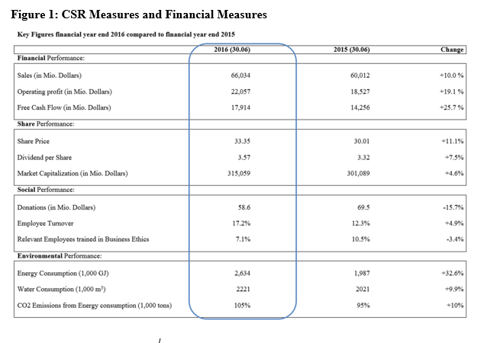
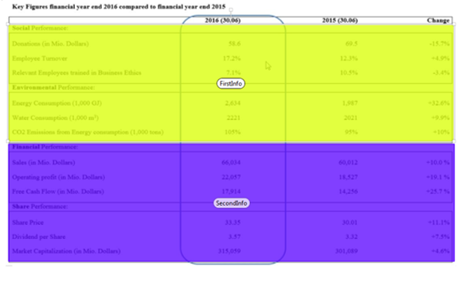
Sustainability Research
Reporting
Issue: Is disclosing metrics sufficient to support decisions?
Fehrenbacher, D., and Soderstrom, N. Effect of CSR Information Presentation Order on Stakeholder Decision-Making. WP 2019.
Using an experiment, we investigate whether the order of presentation of CSR versus financial information impacts the way that decision-makers use the information.

Slide 91
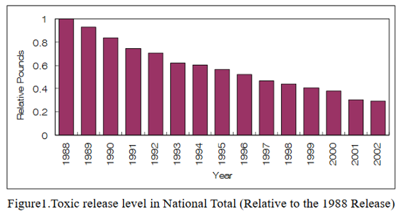
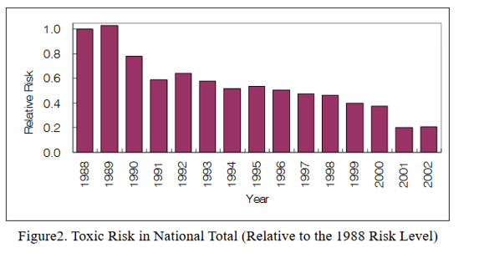
Sustainability Research
Reporting
Issue: Is disclosing metrics sufficient to support decisions?
Providing context matters!
Bae, H., Wilcoxen, P. and Popp, D. “Information disclosure policy: Do states’ data processing efforts help more than the information disclosure itself?” NBER Working Paper 14409. 2008
States focusing on data dissemination have a significant reduction in toxic releases, but no effect on toxic risk within the state. States focusing on data processing (provides structured and interpreted information such as health effects and risk analysis or trend and ranking analyses) have no effect on toxic release levels but reduce toxic risk.
Insights: Stakeholders demand and make use of broader disclosures that help communicate context. Further, reporting format matters.

Slide 92
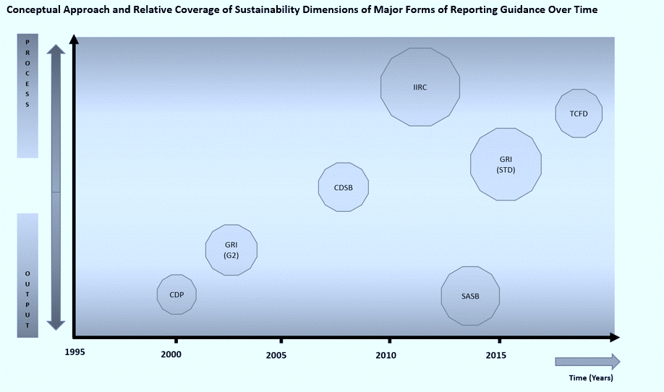
Sustainability Research
Reporting
Issue: What is the reporting landscape?
Soderstrom, N., Khan, A., and Solano, R. “The Management Accounting (R)Evolution in Sustainability Reporting” China Management Accounting Review. 2020

Slide 93
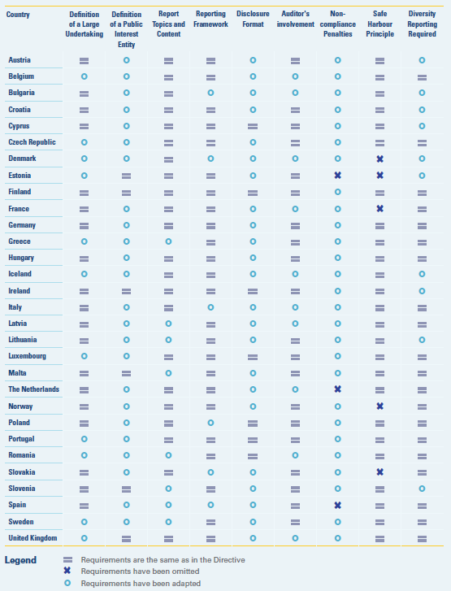
Sustainability Research
Reporting
Issue: What is the reporting landscape?
EU Directive 2014/95/EU
Non-financial and Diversity Information
Key Report Features:
Environmental
Social and employee matters
Respect for human rights
Anti-corruption and bribery matters
Information about these matters to be included:
Business model
Policies pursued in relation to the matters
Outcomes of the policies
Risks associated to matters
Non-financial key performance indicators
Information should be in the management report or a separate report provided within 6 months of the B/S date. If separate, should be available on the website and referenced in the management report.

Slide 94
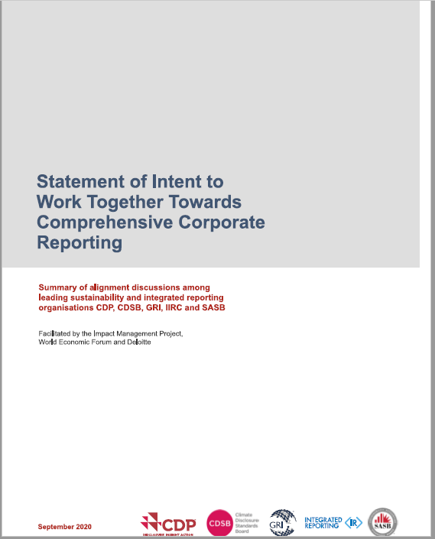
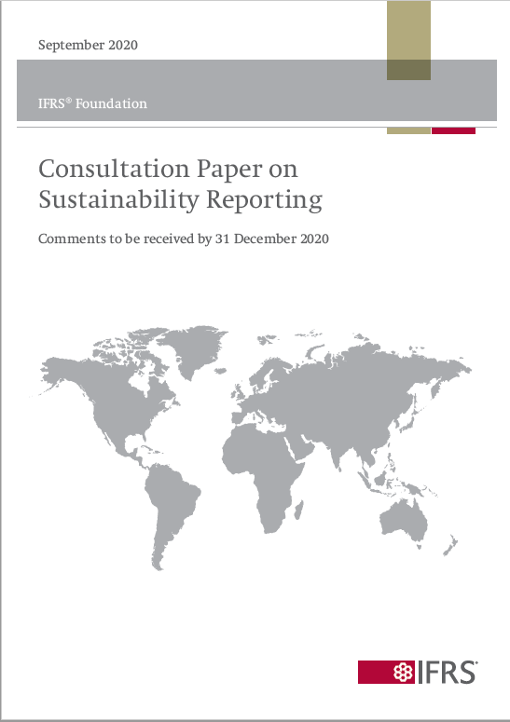
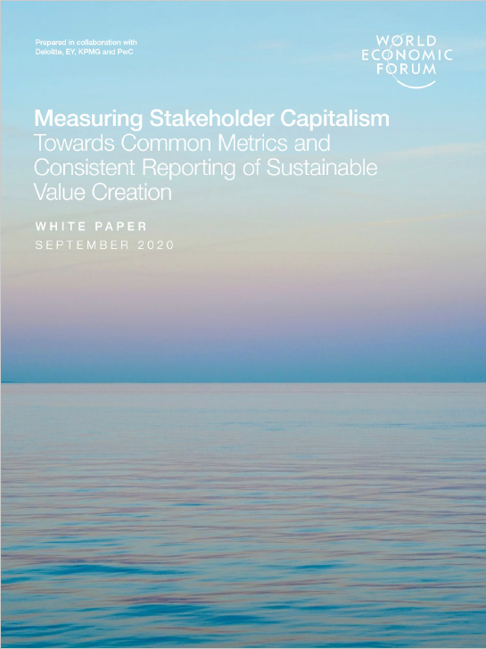
Sustainability Research
Reporting
Issue: What is the reporting landscape?
Happenings in September 2020:
Insights: The landscape keeps changing (which makes it hard for research to keep up). We need to work together!

Slide 95
Sustainability Research
Monitoring
Issue: What is the role of auditors/assurance?
Chen, H., Letmathe, P., and Soderstrom, N. “Estimation Bias and Monitoring in Clean Development Mechanism Projects” Contemporary Accounting Research. doi: 10.1111/1911-3846.12609, 2020.
Auditors from accounting firms help reduce bias in reporting of expected returns from projects submitted to the UN’s Clean Development Mechanism.
  Admission to the program allows companies to earn emission credits that can be sold.
  Projects must be financially unviable without revenues from the credits.
Insight: The assurance function can help regulatory programs be more effective

Slide 96
Sustainability Research
Monitoring
Issue: What is the role of auditors/assurance?
Pinnuck, M, Ranasinghe, A., Soderstrom, N., and Zhou, J. “Restatement of CSR Reports: Frequency, Magnitude and Determinants.” WP 2020
We examine restatements of sustainability reports.
  39% of our sample of the largest 250 companies in the world have restate at least one line item in their sustainability report
  Assured reports are more likely to include restatements
  Assured reports are more likely to have restatements that address prior overstatements of performance
  Note that we don’t find evidence that bias in restatements is intentional—it is more likely that they result from improvements in information systems
Insight: The assurance function not only helps to guard against opportunistic reporting, but it also facilitates improvement of reporting systems.

Slide 97
Sustainability Research
Decision Making
Issue:
What is the impact of sustainability issues on decisions?
Li, C., Luo, J., and Soderstrom, N. “Air Pollution and Analyst Information Production.” Journal of Corporate Finance. 60: 101536, 2020.
Pollution has indirect effects on the functioning of capital markets by affecting analyst forecasting ability. Analysts delay their forecasts and the quality of the forecasts is lower.
Much of the research already discussed illustrates other impacts on decision-making.
Insight: Underlying sustainability issues as well as their reporting have far-reaching influences on the market and on decisions made by a wide range of stakeholders.

Slide 98
Sustainability Research Themes
Decision
Measurement
Reporting
Monitoring
Accounting Practice Belongs Here!
Decision Making

Slide 99


Slide 100
PAC ANNUAL CONFERENCE
Professional Accounting Futures
October 23, 2020
Questions & Answers

Slide 101
PAC ANNUAL CONFERENCE
Professional Accounting Futures
October 23, 2020
Concluding Remarks

