Slide 1
PROFESSIONAL ACCOUNTING FUTURES – 2020
ESG CHALLENGES FACING PROFESSIONAL ACCOUNTANTS
ESG Measurement and Disclosure Challenges
Simon MacMahon, Head of ESG Research
Sustainalytics
October 23rd, 2020

Slide 2
Intro

Slide 3
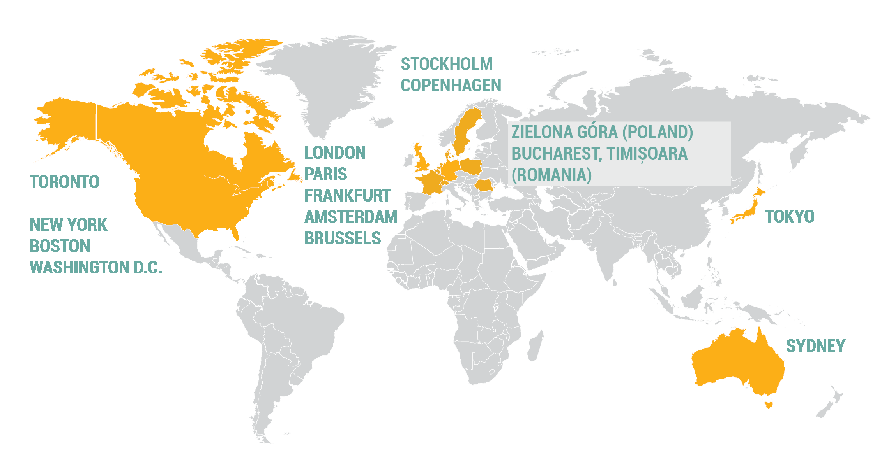
More than 25 years of ESG research solutions to global investors
One of the largest investment research and ratings firm dedicated to responsible investment and ESG research
650 professional staff with more than half engaged in research.
In excess of 700 clients across asset managers, asset owners and investment banks
Over 25 years' experience in the fields of ESG and corporate governance research.
Ownership: Became a Morningstar company in July 2020

Slide 4
Support Throughout the Investment Chain
Targeting outcomes
Our clients use our research and engagement services to target outcomes at both the portfolio and individual company level, for example setting objectives around carbon, global norms and sustainable development.
Post-investment
Active ownership
We support our clients in their engagement with investee companies across asset classes, through research and corporate engagement services, including voting services for public equities.
Reporting and monitoring
Our research is used by clients to monitor investee companies and report internally and externally on a range of metrics. We also provide portfolio reporting tools on our online research portal and through third party platforms.
Investment
Investment Selection
We help our clients identify and understand ESG risks and opportunities in their investable universe to support portfolio construction, the selection process as product creation.
ESG Integration and risk management
Our ESG Risk Ratings and other research products support investors in their fundamental analysis, risk management and during the investment decision-making process
Pre-investment

Slide 5
Sustainalytics
What We Do
We help investors integrate ESG and Corporate Governance factors into their investment processes by providing data, ratings and research to enable more informed investment decisions
ESG Integration | Compliance & Screening | Portfolio Analysis | ESG Engagement Services | Index Services
ESG Risk Ratings Corporate Governance Research & Ratings Carbon Risk Rating Country Risk & Country Screening Sustainable Products Research ESG Data | Global Standards Screening Product Involvement Controversies Research Weapons Research (Controversial Weapons Radar, Arms Trade Research) Country Involvement Human Rights Radar | Portfolio Screening ESG Portfolio Analytics Carbon Portfolio Analytics Portfolio Monitoring (Controversy Alerts, Corporate Governance Insights) | Global Standards Screening Engagement Thematic Engagement Material Risk Engagement | Index Research Services Supported Indexes

Slide 6
ESG Measurement and Disclosure

Slide 7
Sustainalytics’ ESG Research Process
A. Annual Update
B. Controversy Research: Two-Week Cycle
Corporate publications and regulatory filings
NGO reports/websites
News and other media
Company dialogue
Daily search of news sources. social media, specialized publications and non-government organizations
Focus on well-known, respected global and regional media sources
Dedicated research team
Stress & Scenario Testing
Publication of
ESG Rating Report
Daily News Screening
Daily Incident Creation
Bi-weekly Event Updates
Bi-weekly Controversy Rating Update
Company Feedback
Risk Appetite
Risk Culture
Research Process
Quality and Peer Review
Company
Data
Analysis
Media and NGO Information

Slide 8
ESG Indicator Types
Exposure Indicators
Management Indicators
Events Indicators
Product/Activity Involvement
Industry
Policies
Policies
Product Involvement (Negative)
Geographic
Programs and Management Systems
Programs and Management Systems
Solutions Involvement (Positive)
Business Model
Disclosure and Compliance Initiatives
Disclosure and Compliance Initiatives
Activity Based Research
Financial Health
Performance/ Outcomes
Performance/ Outcomes
Relevance,
Simplicity,
Efficiency,
Comparability,
Consistency,
Durability,
Unbiased,
Distributed, and
Orthogonal

Slide 9
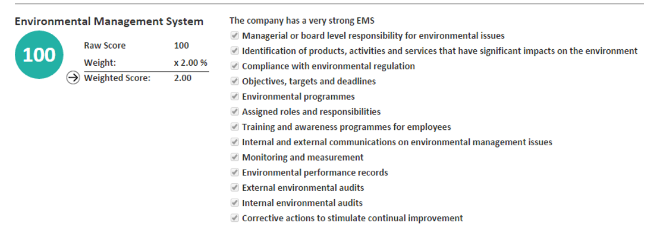
Indicators and weights
Example: Management Indicators
Answer category, e.g. “the company has a strong environmental management system”
Scoring system, e.g. a strong policy requires 7 ticked boxes
Analyst guidance that support analysts in scoring indicators consistently

Slide 10
Current Disclosure Outcomes and Challenges
We have seen ESG Disclosure Rates Rise Dramatically
Approximately 80% of the top 4500 companies produce some form of sustainability reporting
However, Current Disclosure Practices leave a lot to be Desired
Incomplete Disclosures
Only 12 percent of companies report ESG disclosures according to best practice
Average disclosure rate is only 64% across our ESG Risk Rating indicators
Inconsistent Disclosures
We sometimes struggle with disclosures that report according to different standards or that are difficult to normalize.
Low Quality Disclosures
Quantitative disclosures are sometimes of poor/questionable quality

Slide 11
The Changing Regulatory Environment

Slide 12
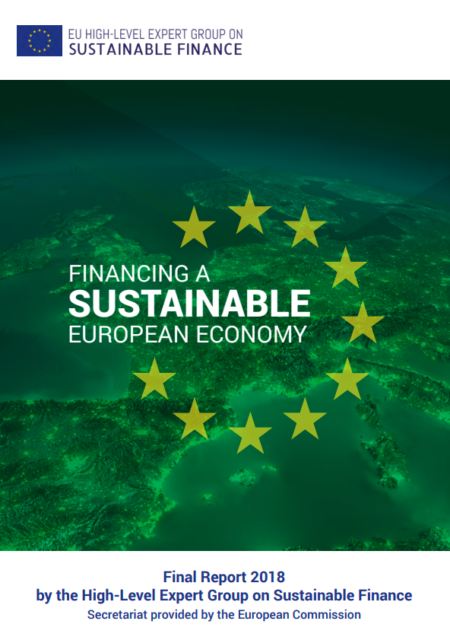
Entering a Very Dynamic Regulatory Period for ESG
Some financial market actors and regulators are questioning whether the current voluntary disclosure regime is working.
Multiple consultations ongoing that ask the question of whether new mandatory ESG disclosure regulations are needed
EU Sustainable Finance Action Plan
ESMA, IFRS, OSC, among others

