Slide 1


Redefining Profit, Value and Success -
ESG 2.0
Sakis Kotsantonis
October 2020

Slide 2
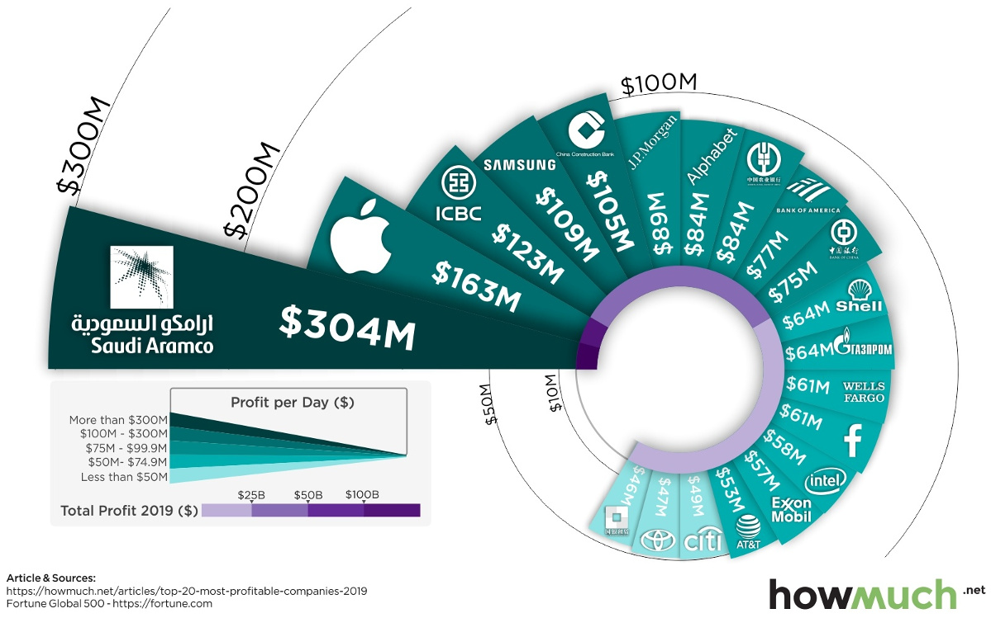
Profit
2

Slide 3
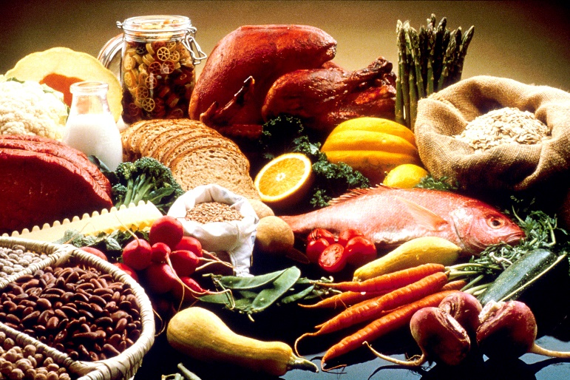
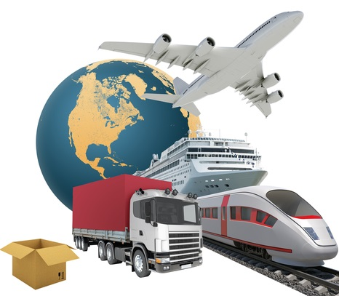


Success
3

Slide 4
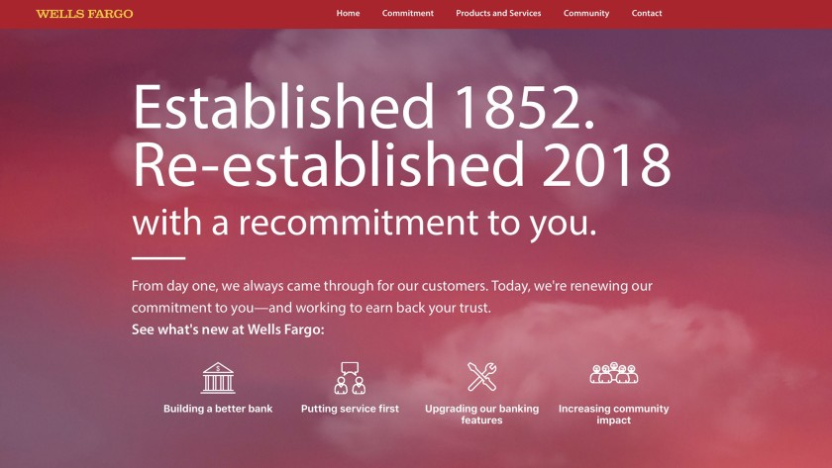
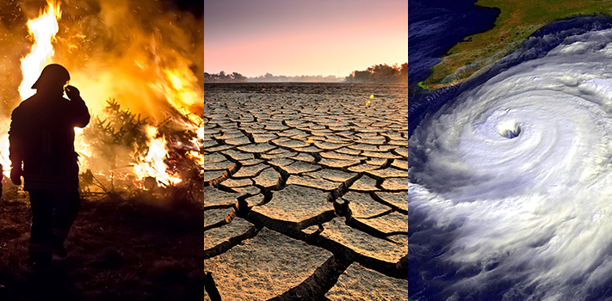
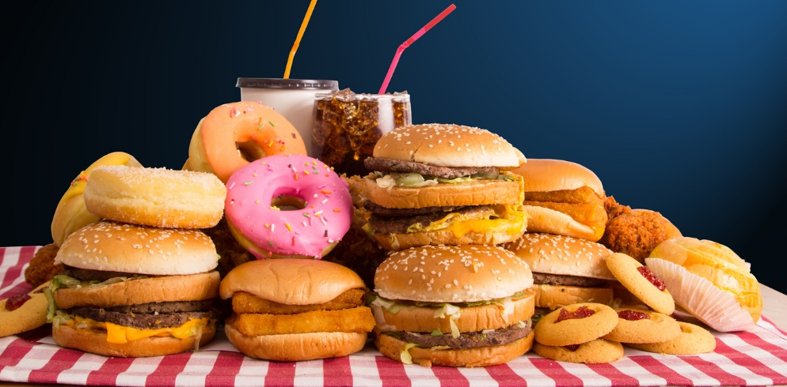

Success?
4

Slide 5

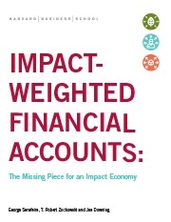




Accounting for Impact – Possible?
Intuitive Measurement Unit | Comparable & Aggregated | Existing Assessment Tools
“Most of the things worth doing in the world had been declared impossible before they were done”
U.S. Supreme Court Justice Louis D. Brandeis (1913)
5

Slide 6



Where to start?
Environment | Employees | Customers
6

Slide 7











Food Products and Retailing
62%
$1,01 Billion
21%
$396 Million
13%
$180 Million
35%
$1,06 Billion
15%
$324 Million
5%
$136 Million
7%
$282 Million
9%
$2 Billion
9%
$1,1 Billion
5%
$669 million
6%
$269 Million
Source: Freiberg, Park, Serafeim, and Zochowski.
“Corporate Environmental Impact: Measurement, Data and Information”
7

Slide 8



No Profits
8

Slide 9
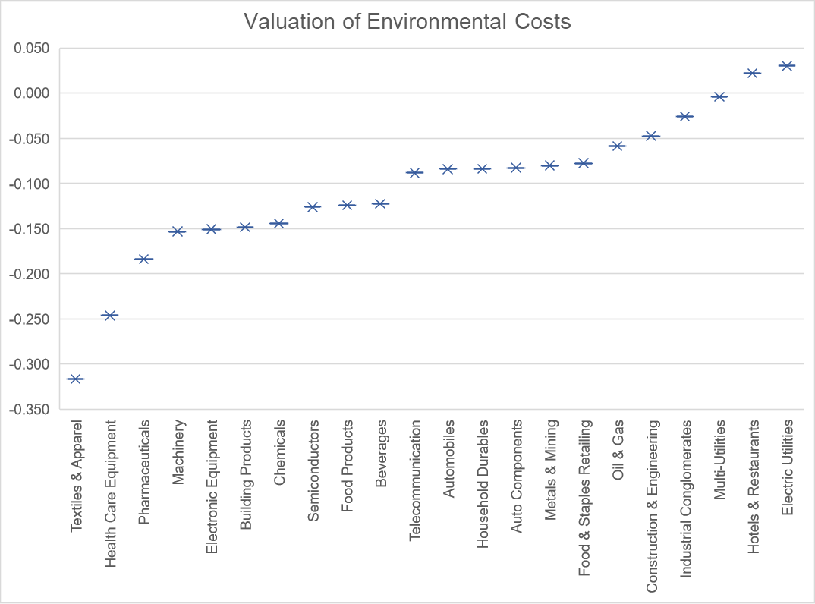
Value
Source: Freiberg, Park, Serafeim, and Zochowski.
“Corporate Environmental Impact: Measurement, Data and Information”
9

Slide 10







Product Impact
Is the product accessible and affordable?
Does the product work as it should? Does it pose health and safety concerns?
What are the emissions’ impacts resulting from product use?
What happens to the product once it has been consumed?
Public company data | Product price, Nutritional assistance (WIC) eligible products | Units Recalled, Nutritional content of product | Emissions from cooking and storage | Recyclability and recoverability of food packaging
Industry assumptions | Average product price, Share of population on nutritional assistance program | Impact of nutrients on chronic disease risk reduction, Medical and indirect cost of chronic diseases | Cost of emissions | Cost of recycled, recovered, and wasted materials
-$3,500m
-$2,400m
-$1,700m
-$865m
$380m
$1,100m
Source: Richmond Global Sciences
10

Slide 11

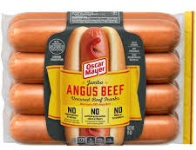

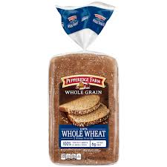
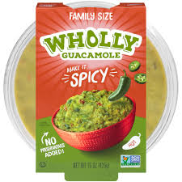

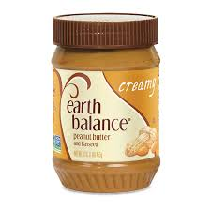
Calculating the Dollar Impact of Packaged Foods companies
Dietary habits are closely linked to cardiovascular disease, which is the leading cause of death in the US as well as its costliest disease, with an estimated price tag of over $555bn per year.
VS
Beef Uncured Franks
$-0.20*
Chocolate Chip Edible Cookie Dough
$-0.96*
Wholly Guacamole
$0.17*
Pepperidge Farm Whole Bread $0.24*
Earth Balance Peanut Butter $0.27*
*2019 Impact related to cardiovascular diseases per 100g of product.
Source: Richmond Global Sciences
11

Slide 12
Product Impact
2019 Company Product Impact in USD bn
Quantity and duration
How many products are sold and what is the average product life?
Recyclability
What happens to the product once it has been consumed?
Quality
Does the product work as it should? Does it pose health and safety concerns?
2019 Product Impact in USD
Access
Is the product accessible and affordable?
Emissions
What are the emissions’ impacts resulting from product use?
Source: Richmond Global Sciences
12

Slide 13
Implications for Accountants?
Impact Weighted Accounting – New generation of accounting statements
Change our intuition about what creates impact
Allow corporate managers to make better informed decisions
Strengthen initiatives
Bring impact to the ESG investing market
“It is better to be roughly right than precisely wrong”
John Maynard Keynes
13

