Slide 1
Non-GAAP Reporting: Evidence from Academia and Current Practice
Dirk Black
Dartmouth College
Ted Christensen
University of Georgia
Jack Ciesielski
R. G. Associates, Inc.
Ben Whipple
University of Georgia
University of Toronto PAC Conference
September 13, 2019

Slide 2
What are non-GAAP earnings?
GAAP earnings plus/minus adjustments such as:
Stock compensation
Depreciation/amortization
Currency adjustments
Unusual gains/losses
M&A costs

Slide 3
Overview
Regulatory background
Academic research
Scope
What have we learned?
What’s happening in practice?
Directions for future research

Slide 4
U.S. Regulatory and Standard Setting Events
SOX / Reg. G
(2002-2003)
SEC Compliance and Disclosure Interpretations (2010, 2011)
Renewed Regulatory and Standard Setting Concern
(2013-2016)
SEC Compliance and Disclosure Interpretation (2016)

Slide 5
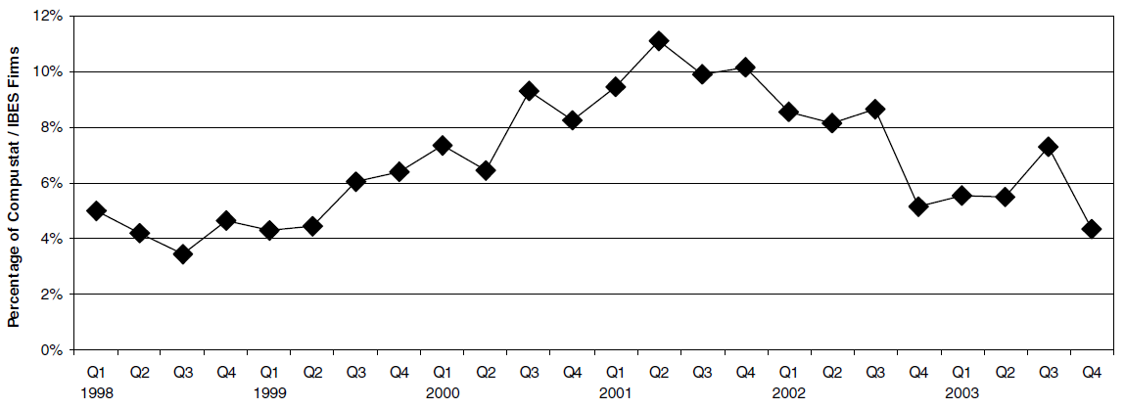
Evolution of the Non-GAAP Reporting Literature
SEC
Warning
SOX
Reg G
C&DIs
C&DIs
Unregulated Non-GAAP Disclosure
Regulated Non-GAAP Disclosure

Slide 6
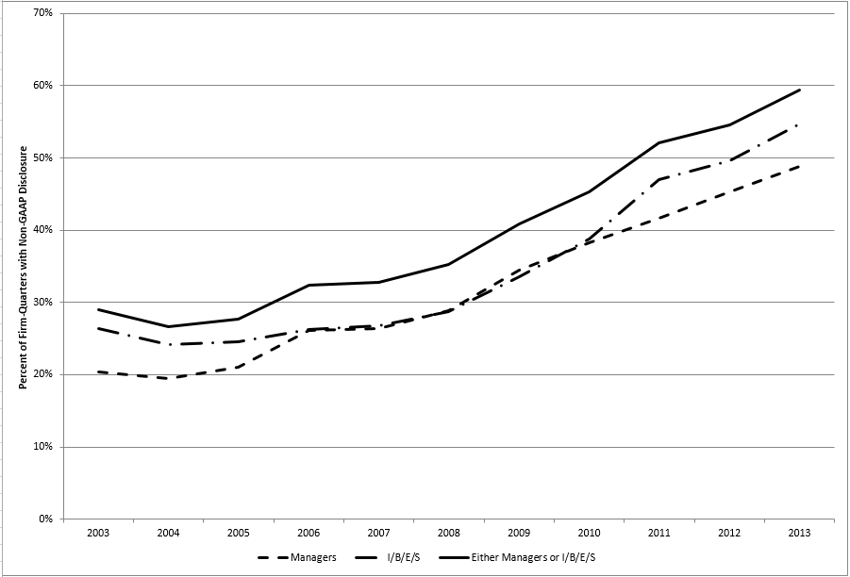
How does this paper fit into the Non-GAAP Reporting Literature?

Slide 7
Evolution of the Non-GAAP Reporting Literature
SEC
Warning
SOX
Reg G
C&DIs
C&DIs
Unregulated Non-GAAP Disclosure
Regulated Non-GAAP Disclosure
Early research focused on finding the “Bad Guys”
Mounting evidence that MOST non-GAAP reporting is now motivated by informativeness

Slide 8
Questions Researchers have addressed:
Do Investors Pay Attention to Non-GAAP Performance Metrics?
Who Uses Non-GAAP Information?
What Adjustments Are Commonly Used To Calculate Non-GAAP Earnings?
What Motivates Managers and Analysts to Provide Non-GAAP Performance Metrics?
What Roles Do Managers And Analysts Play in Determining Non-GAAP Earnings?
Does Measurement Error Cast Doubt On Prior Evidence?
How Has Regulation Influenced Non-GAAP Reporting?
How Do Other Monitoring or Disciplining Mechanisms Influence Non-GAAP Disclosure?
How Does Non-GAAP Reporting Differ Outside of the U.S?
Sources of Non-GAAP Data

Slide 9
Do Investors Pay Attention to Non-GAAP Metrics?
Skepticism by regulators and the financial press
GAAP versus Non-GAAP Performance Metrics
What do investors care about most?
The “horse race” literature (early 2000s)

Slide 10
Do Investors Pay Attention to Non-GAAP Metrics?
Bradshaw and Sloan (JAR 2002)
Non-GAAP earnings has replaced GAAP earnings as the primary determinant of stock process.
Bhattacharya et al. (JAE 2003)
Investors/Analysts react more to non-GAAP earnings
Context
Lougee and Marquardt (TAR 2004)
More useful when GAAP earnings informativeness is low.
Marques (RAST 2006)
Investors trust analysts, but not incremental adjustments by managers.
Bradshaw et al. (JAE 2018)
Definitive evidence: Investors respond more to non-GAAP metrics.

Slide 11
Who Uses Non-GAAP Information?
LESS SOPHISTICATED INVESTORS
Experimental Research
Frederickson and Miller (TAR 2004)
Elliott (TAR 2006)
Archival Evidence
Allee et al. (AOS 2007)
Bhattacharya et al. (TAR 2007)
MORE SOPHISTICATED INVESTORS
Short sellers target non-GAAP reporting firms
Christensen, Drake, Thornock (CAR 2014)
The “threat” of short selling disciplines disclosure
Bhattacharya et al. (2018)

Slide 12
Who Uses Non-GAAP Information?
COMPENSATION COMMITTEES
Curtis et al. (WP 2015), Black et al. (WP 2018)
Compensation incentives influence reporting (Bansal et al., 2013; Grey et al., 2013; Isidro and Marques, EAR 2013; Scheetz and Wall, WP 2014)
CREDITORS
Dyreng, Vashishtha, and Weber (WP 2017)
Christensen, Pei, Pierce & Tan (WP 2017)

Slide 13
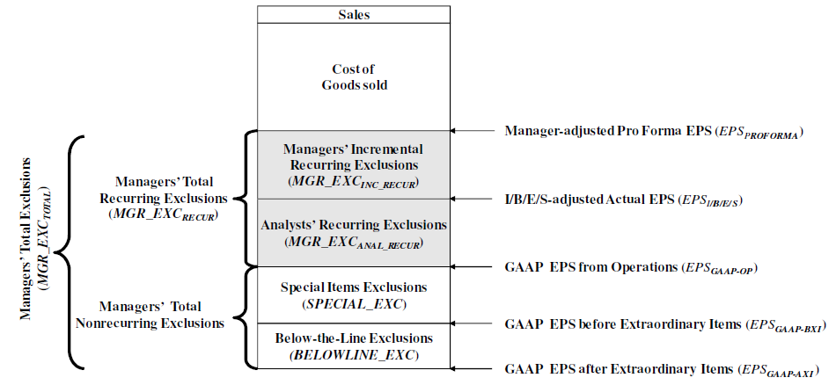
3. What adjustments are commonly used?
Limits to academic research (absent hand collection)

Slide 14
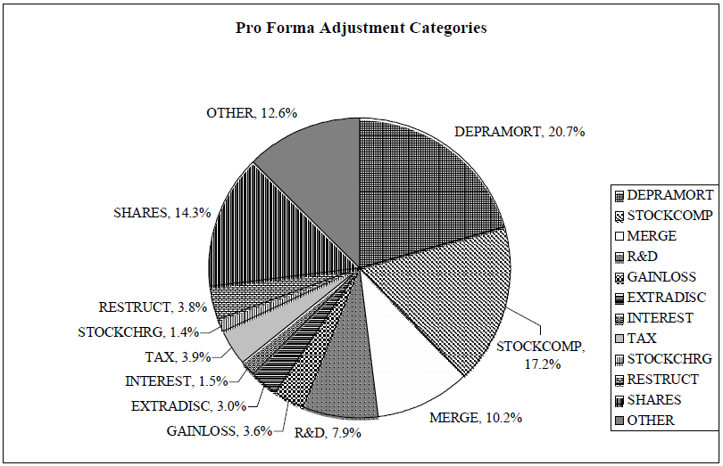
3. What Adjustments Are Commonly Made?
Several studies with hand collected samples have attempted to summarize what happens in practice.
Bhattacharya et al. (Horizons 2004)
Black & Christensen (JBFA 2009)
Whipple (WP 2016)
Bentley et al. (JAR 2018)

Slide 15
What Motivates Non-GAAP Disclosure?
Motive: Informativeness
Managers exclude transitory items:
Better mapping into future operating earnings and cash flows (Doyle, et al. RAST 2003; Kolev et al. TAR 2008)
Investors respond more to non-GAAP earnings
Bradshaw et al. (JAE 2018)
Analysts use discretion consistent with informativeness
Use expertise to exclude based on persistence (Gu and Chen JAE 2004)

Slide 16
What Motivates Non-GAAP Disclosure?
Motive: Opportunism
Differentially exclude transitory losses and gains
Curtis et al. (TAR 2014), Bentley et al. (JAR 2018)
Recurring item exclusions (Doyle et al. RAST 2003)
Strongly related to future earnings and cash flow
Smaller cash flow association in current period
Benchmark Beating (Bhattacharya et al. JAE 2003)
Convert a GAAP loss to a non-GAAP profit
GAAP miss, but Street beat
Others:
Strategic emphasis (Bowen et al. TAR 2005)
Earnings management (Black et al. CAR 2017c)
Opportunism associated with investor sentiment (Brown et al. JAR 2012)

Slide 17
What Roles Do Managers And Analysts Play in Determining Non-GAAP Earnings?
Who is responsible?
Managers report non-GAAP metrics in EA
Investors/analysts want this information
Firms use these metrics internally
Agree with analysts’ metric about 2/3 of the time.
Analysts provide non-GAAP metrics in reports
To focus on core earnings
Industry standard
Managers focus on these metrics
Investors react most strongly to adjustments made by both parties.

Slide 18
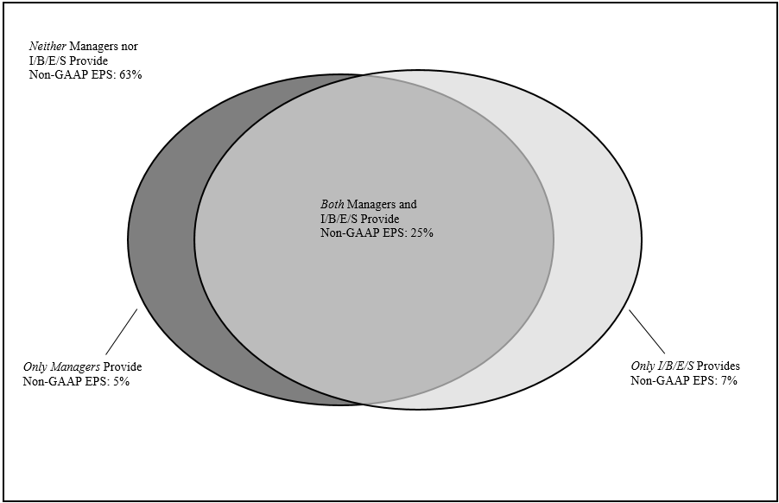
Managers and Analysts’ Roles
Bentley et al. (JAR 2018)

Slide 19
Managers and Analysts’ Roles Over Time
Bentley et al. (JAR 2018)

Slide 20
Does Measurement Error Cast Doubt On Prior Evidence?
Measurement error is a significant concern in the extant literature (Cohen et al. RAST 2007; Christensen RAST 2007a)
Important alternative explanation that many studies could not rule out
Authors and discussants caution against relying too heavily on their evidence (Bradshaw JAE 2003, Easton, RAST 2003; Berger CAR 2005; Christensen, CAR 2007b)
Bradshaw et al. (JAE 2018)
Overcome measurement error using new data
Find that important inferences hold
Provide new evidence masked by measurement error

Slide 21
How Has Regulation Influenced Non-GAAP Reporting?
Regulation G: targeted at non-GAAP reporting
Temporary reduction in reporting
(Nichols et al., RIR 2005; Marques, RAST 2006; Entwistle et al., Horizons 2006; Heflin and Hsu, JAE 2008)
Firms with lowest quality non-GAAP metrics stopped reporting
(Entwistle et al., Horizons 2006; Kolev et al., TAR 2008; Heflin and Hsu, JAE 2008; Black et al., JAAF 2017e).
Adjustments now relate to items that are more transitory in nature (Kolev et al., TAR 2008).
Less evidence of meet or beat (Doyle et al, JAE 2013).
Stronger investor response to non-GAAP and less evidence of mispricing
(Marques, RAST 2006; Black et al., JBFA 2012; Zhang and Zheng, JAE 2011).
SEC Interpretive Guidance: Relax or clarify Reg. G
Continued improvement (Kyung and Weintrop, WP 2016)

Slide 22
How Has Regulation Influenced Non-GAAP Reporting?
Reg G
SEC Interpretations
Improved exclusion quality
Temporary
reduction
Continued improvement
Greater investor informativeness
Low quality disclosers dropped out

Slide 23
How Do Other Monitoring or Disciplining Mechanisms Influence Non-GAAP Disclosure?
Independent board (Frankel et al. RAST 2011)
Analysts (Christensen et al., WP 2017a)
Creditors (Christensen et al., WP 2017b)
Compensation committees (Black et al., WP 2018)
Auditors (Chen et al., JAPP 2012)
Litigation risk (Bentley et al., JAR 2018; Cazier et al., WP 2017)

Slide 24
How Does Non-GAAP Reporting Differ Outside of the U.S?
There are differences across regulatory regimes (Young 2014):
UK (Choi et al., 2007; Lin and Walker, 2000),
France (Aubert, 2009),
Germany (Hitz, 2010),
South Africa (Venter et al., 2014);
Australia (Cameron et al., 2012; Malone et al., 2016),
New Zealand (Rainsbury et al., 2012)
European countries (Isidro and Marques 2013, 2015).
Some results are similar to the U.S. but others differ.

Slide 25
Sources of Non-GAAP Data
Forecast Data Provider (FDP) earnings
Used to examine analysts’ behavior (e.g., Gu and Chen JAE 2004;
Used to proxy for manager disclosures (e.g., Doyle et al., RAST 2003; Kolev et al., TAR 2008; Heflin and Hsu, JAE 2008)
Manager-disclosed data
Hand collected (e.g., Bhattacharya et al. JAE 2003; Lougee and Marquardt TAR 2004; Marques RAST 2006; Wang, 2014; Lee and Chu, 2016; Leung and Veenman, 2016 )
Programmatic searches (e.g., Bentley et al., JAR 2018; Black et al., WP 2018; Brockbank, WP 2017)
Commercial databases (Audit Analytics)

Slide 26
Increased Focus on Non-GAAP
SEC, FASB, and IASB have all recently commented on non-GAAP reporting
SEC:
Expressed concern regarding misleading metrics
Issued a Compliance and Disclosure Interpretation
Discussed potential need for more regulation
FASB & IASB:
What does proliferation of non-GAAP metrics mean for GAAP- and IFRS-based metrics?
At least 30 articles in major press outlets in 2016

Slide 27
Research and the Current Environment
Prior to this study academics had little detailed evidence to provide regulators and standard setters about the current environment
Bentley et al. (JAR 2018); Whipple (WP 2016)
Need a better grasp of the details and firms’ reporting consistency and comparability

Slide 28
The Role of Auditing in Non-GAAP Reporting
WHY HAS THE QUALITY OF NON-GAAP REPORTING IMPROVED?
Prior JAR Conference:
The Role of Gatekeepers in Accounting
We have extensive research on how various “gatekeepers” serve as monitoring or disciplining forces that ensure high quality non-GAAP reporting!

Slide 29
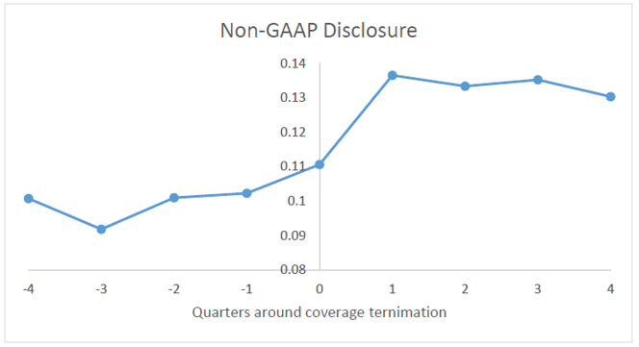
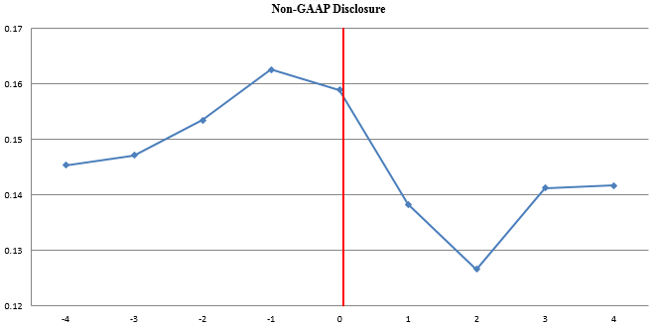
The Role of Auditing in Non-GAAP Reporting
Disciplining Mechanisms:
Regulation
Analysts
Creditors
Short Sellers
Compensation Committees
Litigation Risk
Corporate Governance
Shouldn’t Auditors play a similar role???

Slide 30
Analysts’ Role in Monitoring non-GAAP Reporting: Evidence from a Natural Experiment
Ted Christensen
University of Georgia
Enrique Gomez
University of Georgia
Matthew Ma
Southern Methodist University
Jing Pan
Southern Methodist University

Slide 31
Overview
RQ: How do analysts influence non-GAAP reporting?
Exploit exogenous reductions in analyst coverage
Examine likelihood and quality of non-GAAP disclosures

Slide 32
Overview
After reductions in analyst coverage:
Firms are more likely to report non-GAAP earnings.
However, those that do provide them report lower quality non-GAAP metrics (on average).
Results are stronger for firms:
with lower analyst coverage
that lose analysts with higher industry expertise
with lower board independence
lower auditor tenure
higher past earnings management

Slide 33
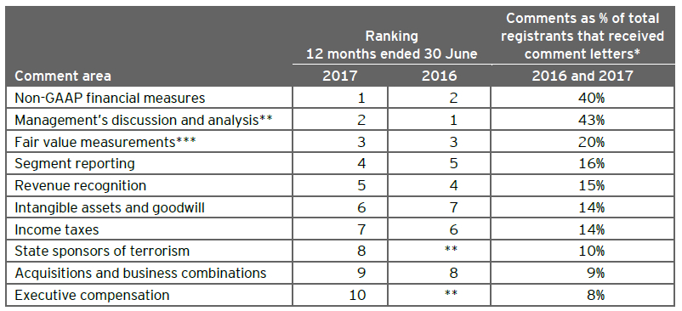
Motivation
Source: Ernst and Young (2017)

Slide 34
Managers’ Incentives
Informative
When GAAP earnings are noisy, managers can provide a clearer non-GAAP signal (Black et al. 2017; Entwistle et al. 2005; Kyung et al. 2016)
Opportunistic
There may be situations in which managers are motivated to inflate perceptions of (overstate) operating performance (Black et al. 2017; Doyle et al. 2003; Landsman et al. 2007)
Notes:
Many argue that non-GAAP earnings better reflect firms’ core performance and are more informative.
Critics argue that non-GAAP earnings are “earnings minus everything else that went wrong.”
Informative:
Decrease information asymmetry (Balakrishnan et al. 2014).
Reduce the cost of capital (Derrien and Kecskes 2013, Kecskes and Mansi 2015)
Regain attention (Barber and Odean 2007).
Opportunistic:
Earnings management to mislead investors (Irani and Oesch 2014, Fich, Juergens and Officer 2014).

Slide 35
Background
Monitoring (or constraining) non-GAAP disclosures
Other mechanisms in prior research:
Board independence (Frankel, McVay, and Soliman 2011)
Creditors (Christensen et al. 2017)
Litigation Risk (Cazier, Christensen, Merkley, and Treu (2017)
Auditors (Chen, Krishnan, & Pevzner 2012)
Analysts (Bentley et al. 2018, Black et al. 2018)?
Notes:
- Frankel, McVay, and Soliman (2011) find that board independence is positively associated with the quality of non-GAAP earnings,
while Isidro and Marques (2013) find that a strong board of directors can decrease aggressive non-GAAP reporting.
-Christensen et al. (2017) find that the quality of non-GAAP reporting improves following a debt covenant violation,
presumably because both creditors and shareholders take on a stronger monitoring role.
- Cazier, Christensen, Merkley, and Treu (2017) use a quasi-natural-experimental setting in which US federal appeals court rulings
result in significant changes in litigation risk and employ a difference-in-differences design to explore how these
circuit-specific shocks influence firms’ propensity to provide a non-GAAP performance metric. They find that firms
increase (decrease) their non-GAAP reporting activity when litigation risk decreases (increases).
- Chen, Krishnan, & Pevzner, 2012: Higher fees and more likely to resign for firms with more opportunistic NG #s. Suggesting that to some degree auditors restrictthe aggressiveness of non-GAAP metrics.

Slide 36
Analysts’ Monitoring Role
Analysts ‘overseeing’ firm activities increases the breadth of information dissemination, which in turn lowers the cost of monitoring for investors and other stakeholders (Jensen and Meckling 1976).
Track firm disclosures and question non-GAAP reporting during conference calls (Black et al. 2018).
Analysts also provide non-GAAP numbers that investors can use to compare to manager numbers (Bentley et al. 2018).
Notes:
Managers increase accrual based earnings management but decrease real earnings management (Irani and Oesch 2014).
Firms followed by more analysts manage earnings less (Yu 2008).
Analysts and non-GAAP reporting
Generally believed to be more informative in their exclusion choices.
They also exclude one-time items (Brown et al. 2015).
Less likely to have a motive of misleading investors.
Some state they use non-GAAP metrics because managers focus on them.
Others argue that managers’ reporting choices have little influence.
Question exclusions during the Q&A portion of calls.

Slide 37
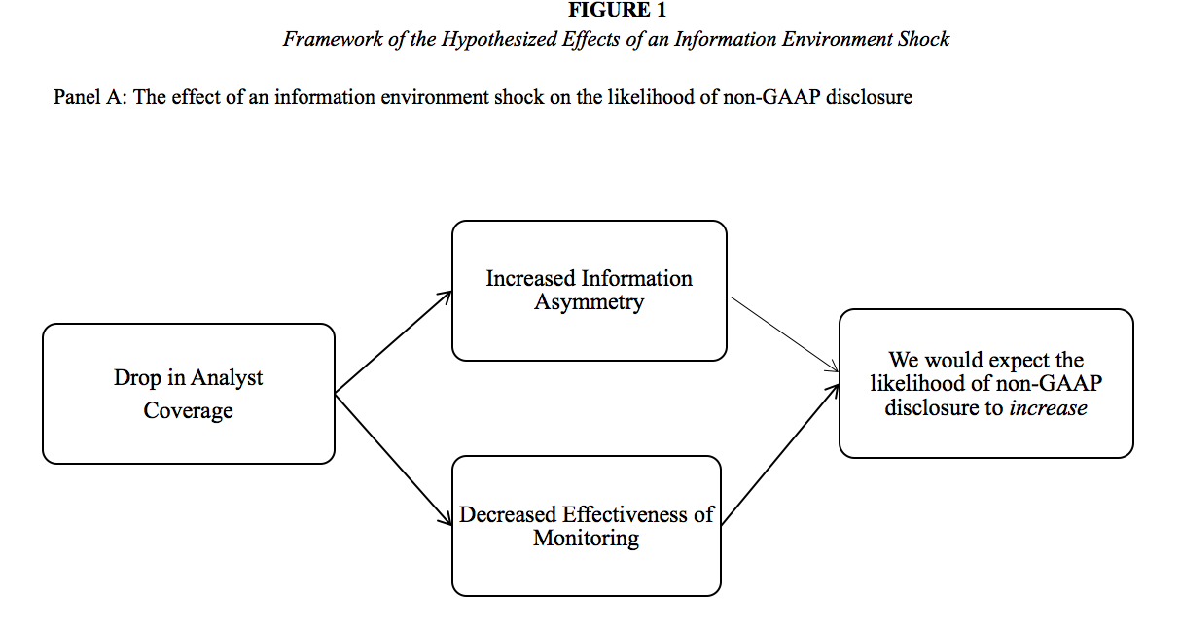
Big Picture: Figure 1, Panel A

Slide 38
Big Picture: Figure 1, Panel A

Slide 39
The Likelihood of Disclosing Non-GAAP Earnings
Hypothesis 1: The likelihood that managers will voluntarily disclose non-GAAP performance metrics increases following analyst coverage terminations.

Slide 40
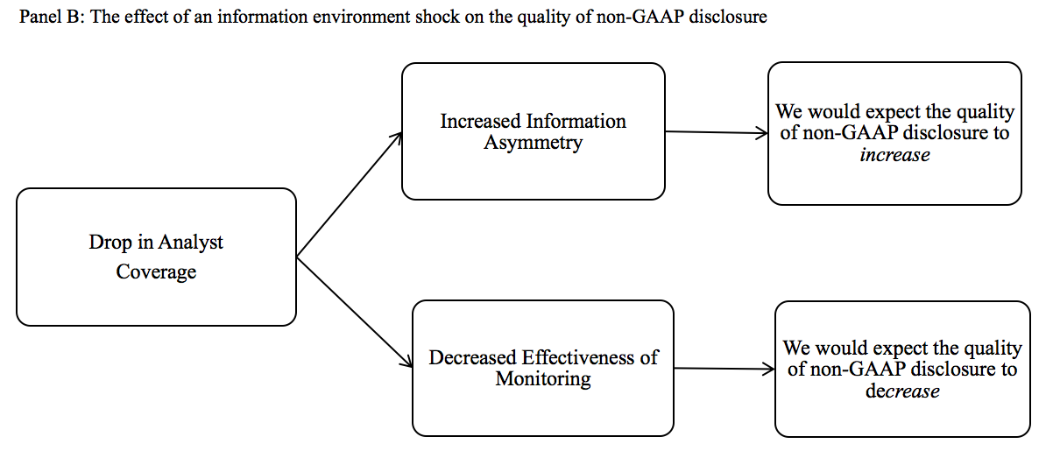
Big Picture: Figure 1, Panel B
Information Motive
Opportunistic Motive

Slide 41
The Quality of Non-GAAP Disclosures
Hypothesis 2: Non-GAAP reporting quality does not change following exogenous analyst coverage terminations.

Slide 42
Coverage Terminations
List of mergers and closures from Hong & Kacperzyk (2010), Kelly & Ljungqvist (2012).
Supplemented our list of mergers and closures with 20 extra events from Chen, Chiu, and Shevlin (2018).
Verified broker termination dates in Thomson Reuters, SDC, PR Newswire, and Business Wire on LexisNexis.
Total of 46 events from January 2003 to December 2012.
Notes:
Hard to remain profitable (research usually a cost center).
Decrease in revenue in market-making, investment banking.

Slide 43
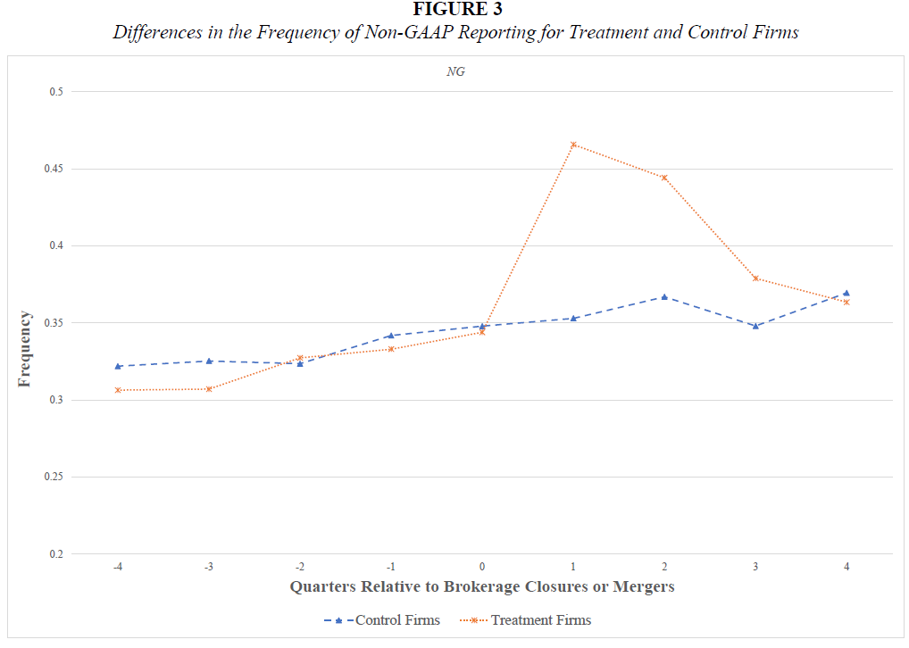
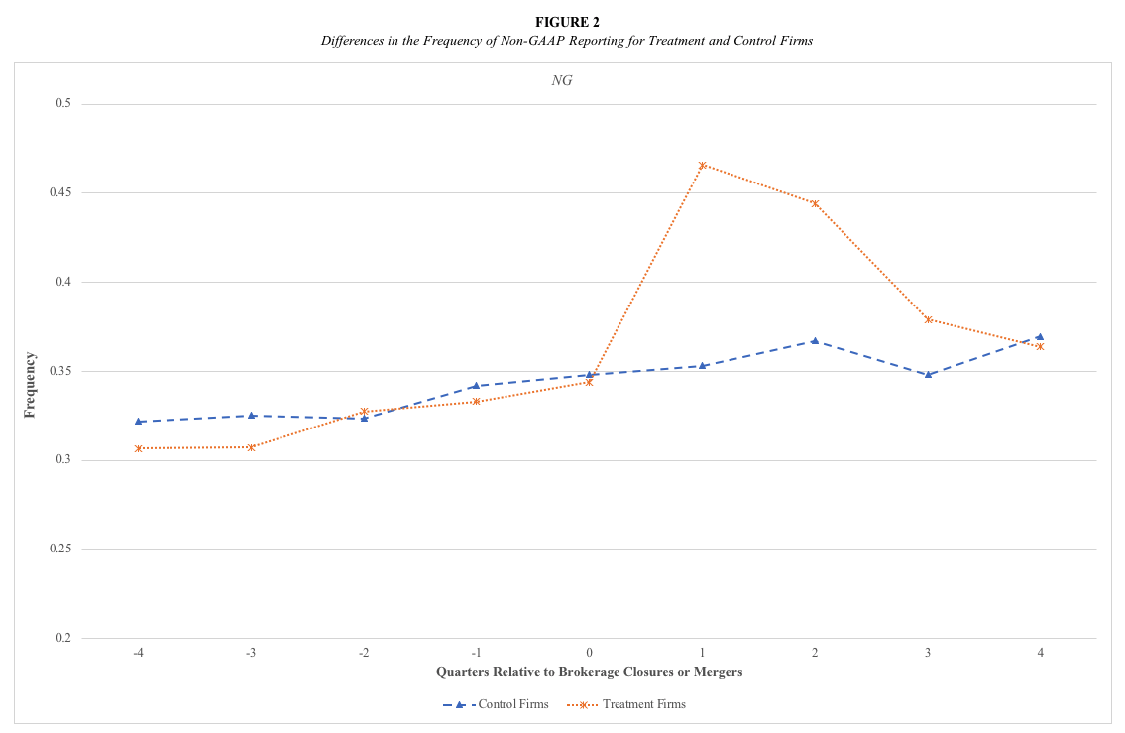

Slide 44
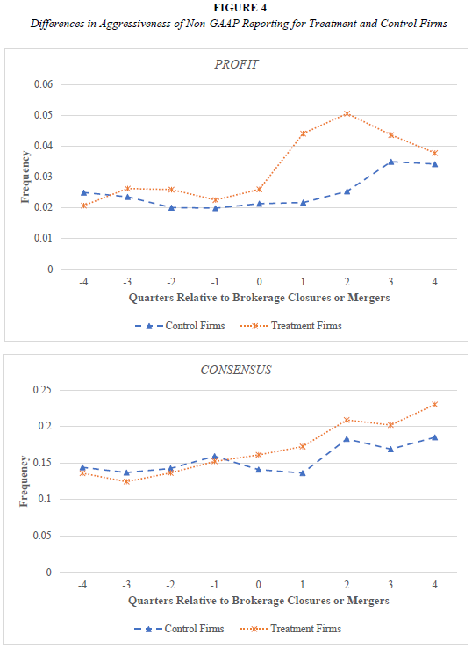
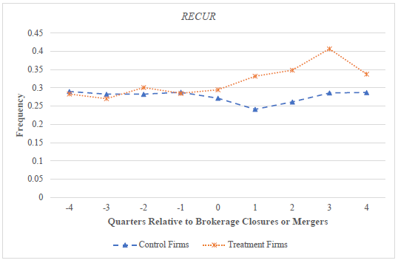

Slide 45
Coverage Terminations
Endogeneity complicates the examination of analysts’ role.
Analysts tend to cover firms with specific disclosure attributes.
Firms change disclosure choices to retain analysts.
Broker closures or mergers give rise to exogenously terminate analyst coverage.

Slide 46
Methodology
Propensity to disclose non-GAAP earnings
Control for
Other variables related to non-GAAP disclosures
Cluster by firm
Industry fixed effects
Year-quarter fixed effects

Slide 47
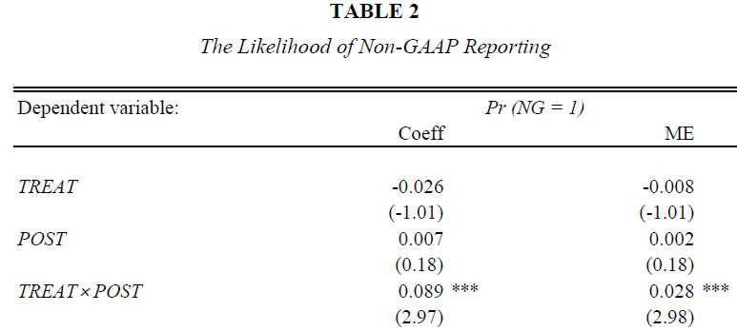
Results

Slide 48
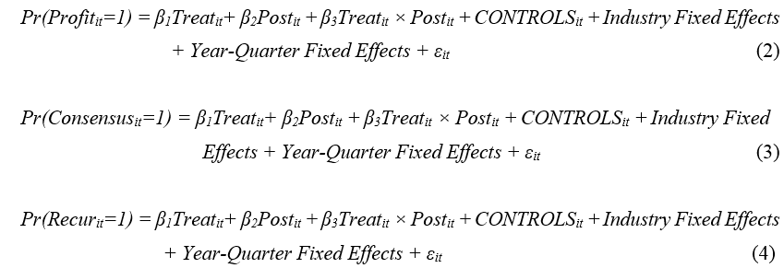
Methodology
Aggressiveness of non-GAAP reporting
Control for
Other variables related to non-GAAP disclosures
Cluster by firm
Industry fixed effects
Year-quarter fixed effects

Slide 49
Results

Slide 50
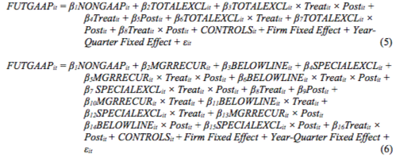
Methodology
Quality of exclusions
Control for
Other variables related to non-GAAP disclosures
Cluster by firm
Firm fixed effects
Year-quarter fixed effects
Notes:
Special items = EPS from operations less GAAP earnings per share.
Other Exclusions = Total exclusions less special items
Total exclusions = non-GAAP earnings less income before extraordinary items.

Slide 51
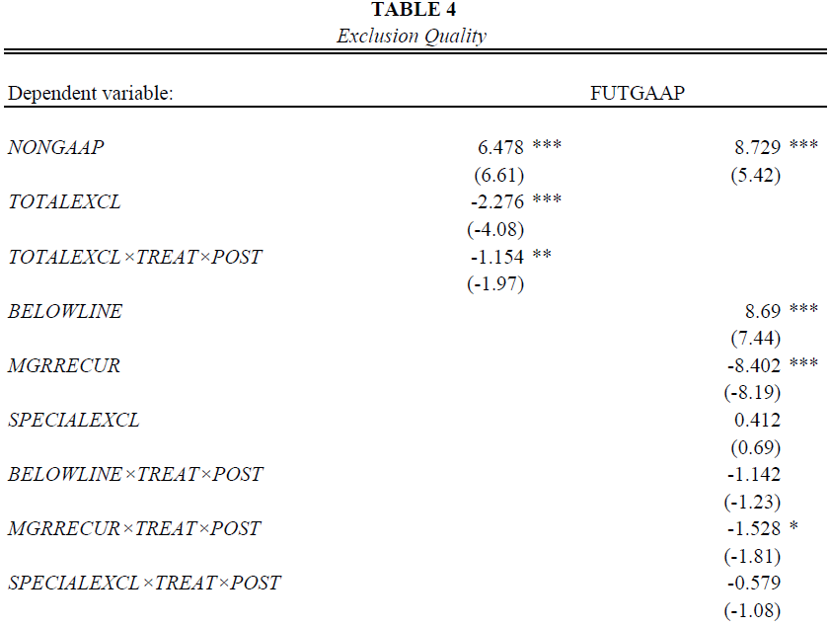
Results

Slide 52
Cross-sectional Tests: Level of Coverage
Prior studies argue that the marginal value of analyst coverage declines as the number of analysts who cover a firm increases.
When a firm has fewer analysts, a loss of an analyst represents a greater percentage loss of analyst coverage.
We expect our results to be concentrated in treatment firms with low analyst coverage.

Slide 53
Table 5- Tests Conditional on Level of Coverage

Slide 54
Cross-sectional Tests: Monitoring Ability
Analysts with more industry expertise should have greater monitoring ability (if observed changes are attributable to weakened monitoring).
We measure industry expertise based on the proportion of firms that analysts cover within the same industry.

Slide 55
Table 6- Tests Conditional on Analyst Industry Expertise

Slide 56
Cross-sectional Tests: Corporate Governance
Strong corporate governance ensures greater monitoring (e.g., Shleifer and Vishny, 1997; Denis and McConnell, 2003; Armstrong, Core, and Guay, 2014)
We expect analysts’ monitoring to be more important in firms with weaker corporate governance.
We capture a firm’s governance effectiveness with two measures: board independence, and auditor tenure.

Slide 57
Table 7- Tests Conditional on Board Independence

Slide 58
Table 8- Tests Conditional on Auditor Tenure

Slide 59
Cross-sectional Tests: Past Earnings Management
Black et al. (2017) argue that non-GAAP reporting is just one perception management tool used by managers.
Managers prefer to use real earnings/accruals management.
They turn to non-GAAP reporting once these have been exhausted.
We expect that managers of treated firms are more likely to report opportunistically if they have these constraints.
We use the level of past earnings management (NOA) to proxy for managers’ flexibility to manage accruals (Barton and Simko 2002).

Slide 60
Table 9- Tests Conditional on Past Earnings Management

Slide 61
Conclusion
The likelihood of non-GAAP reporting increases following drops in coverage.
Non-GAAP disclosure quality is lower.
Results consistent with some managers exhibiting opportunistic behavior.
Analysts can play a monitoring role.

Slide 62
Contribution
Analysts have a substantial influence on managers’ non-GAAP reporting practices
Monitoring of non-GAAP disclosures
Analysts seem to serve as a monitoring mechanism
Informativeness vs. opportunism debate
Crafting rules that mitigates opportunism without killing useful information

Slide 63
Questions? Comments?

Slide 64
Thank you!

