Slide 1
Enhancing the Relevance of
Financial Reporting
Professional Accounting Centre
Annual Conference
September 14, 2018
Draft Framework for
Reporting Performance Measures

Slide 2
Purpose
Provide an overview of a new AcSB initiative
  To develop a Framework to improve the reporting of performance measures
Encourage you to join the conversation
2
Notes:
new initiative – overarching framework to as a first step to enhance quality of PMs reported outside of GAAP/financial statements
So investors, contributors & lenders can make more informed resource allocation decisions
Objective – start a conversation
Today – provide an overview and welcome your initial thoughts

Slide 3
Quality of performance measures matters
Source: Deloitte perspectives on corporate reporting, presentation, May 23, 2018
3
Notes:
All companies and organizations use PMs to explain their story/activities
Powerful to explain growth strategies & targets, anticipated sales or ability to provide services
Events like this – when a company identifies error in unit sold or total # of subscribers - can or be one of several factors – that can serious affect on a public companies stock price, its reputation
Possibly trigger other events – like regulator investigation – that resulted inflated sales
Quality of PMs matters – entities need to ensure they have appropriate policies, procedures, controls & governance in place when reporting PMs

Slide 4
Performance measures make headlines
Source: Deloitte perspectives on corporate reporting, presentation, May 23, 2018
4
Notes:
All companies and organizations use PMs to explain their story/activities
Powerful to explain growth strategies & targets, anticipated sales or ability to provide services
Events like this – when a company identifies error in unit sold or total # of subscribers - can or be one of several factors – that can serious affect on a public companies stock price, its reputation
Possibly trigger other events – like regulator investigation – that resulted inflated sales
Quality of PMs matters – entities need to ensure they have appropriate policies, procedures, controls & governance in place when reporting PMs

Slide 5
Our journey
Launched
the Framework
June 14!
RISE OF Non-GAAP METRICS
Veritas Investment Research
THE NUMBERS GAME
Globe & Mail
September 23
Audited Financial Information: Is it Losing Relevance? AASB & CPAB
2016
2017
2018
AcSB User Advisory Council: Discussions in April & June
AcSB Strategy Session: Presentation by Senior Leaders
AcSB takes action
Notes:
From the article: “A new report from Toronto based accounting firm Veritas Investment Research shows rapid growth in the use of non-GAAP measures over the past decade, with over 70 per cent of companies in the S&P/TSX 60 index reporting some form of internally adjusted net income figure in their filings in 2015, compared with fewer than 10 per cent in 2004. The report said 85 per cent to 90 per cent of non-GAAP measures it studied over the past five years had the effect of improving a company's financial picture.”
February 2017 – Panel discussions on relevance of audited financial statements
CFA Society Toronto, AASB, AcSB and CPAB partnered together to solicit input from investors and financial analysts
Surveyed institutional investors representing $3+ trillion assets under administration, and major sell-side analysts, research firms and credit rating agencies
In May 2017, CPAB hosted its fourth Audit Quality Symposium in Toronto. Featuring a variety of corporate directors, investors, and regulators, the symposium explored the relevance of the audit, particularly to investors, and the reliability of information reported outside of the financial statements.
In November 2017, AcSB strategy section – overwhelming support for initiative to enhance relevance of information (measures) users rely on.

Slide 6
Encourage best practices
Performance Measures
Develop a framework
Transparency
Consistency
Expectation Gap
Comparability
Management Compensation
6
Notes:
1st level - Issues heard from users from measures provided today – need to quality of measures used in Canada
2nd level – themes heard
no correlation of performance measures to management compensation
not all users understand level of governance used to develop measures & nature or lack of assurance
not an understanding of type of different information and what is audited or not – need for education
3rd level – Framework – to respond to those concerns:
Not a standard – voluntary guidance
Understandable & easy to read, e.g use of graphics, plain language
Content - Approach to develop measures,
Objective & desirable qualities of measures
Identify principles for how to select, develop and report measures, procedures & controls, governance practices to follow
Benefits of verification
Encouraging best practice when an entity decides to report a PM

Slide 7
All participants in financial reporting need to play a role
Users
Directors and others
Assurance Providers
Preparers
Regulators
For profit and not-for-profit entities
  Enhance the relevance of information users rely on to make resource allocation decisions
    First step
  AcSB is leading a new initiative
    Leverage our strengths
    Start a conversation
7
Notes:
While the Board continues to thinks that financial statement provide a strong foundation for financial reporting
Given those growing concerns about the quality about supplemental information, such as performance measures
Time has come for all of us in involved in financial reporting process to work together
Users – not only understand information but provide feedback on reporting
Preparers – develop & report measures
Directors – how exercise oversight
Independent experts – internal audit, assurance providers
Regulators
AcSB – as a standard setter - leverage its reputation, network & approach – to start the conversation
By working together we can make a difference

Slide 8
Approach
Leveraged
  Learnings from published guidance & materials
  Advice from stakeholders
Objective and qualities of information
  Based on the IASB’s and AcSB’s concept statements
  Similar thought process
8
Notes:
Para 20 and 21a

Slide 9
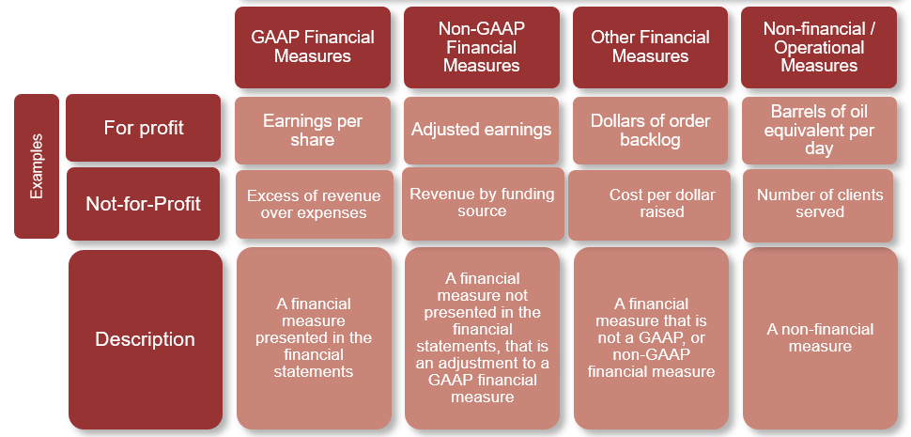
Types of performance measures
Within the scope of Framework
9
Notes:
Scope – clarify users understanding of what these measures are
Talking with CSA – our view - initiative does not conflict but supports their current work to develop a rule on non-GAAP measures
Framework covers a broader range of measures – operational
Focus more on how to select and determine performance measure
Principles/tools to encourage relevant reporting of measures vs specified requirements

Slide 10
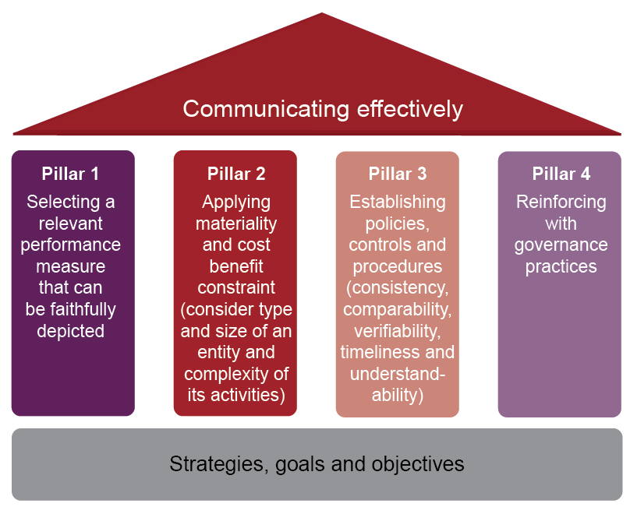
Developing and reporting performance measures
10
Notes:
Operationalize the development of measures – Framework sets out key five principles that lead to communicating information about performance measures effectively
Similar to building a house – set a strong foundation and build & maintain effective pillars and roof = safe and strong house to weather any storm
Foundation – identifying key activities – undertaken & will take to generate value
Pillar 1 – When decide to convey additional information by providing CPM – factors to consider in selecting a relevant measure & depicting it faithfully
Pillar 2 – use materiality and consider benefits > costs
Pillar 3 – Developing & applying robust policies & procedures, e.g. policy set out estimates & judgements will be determined such as types of adjustments may or may not make
Pillar 4 – Reinforce quality through governance – suggest oversight actions – topics to discuss with management about their practices to having independent assessment done (e.g. internal audit or other expert)
Roof – communicating effectively – identify attributes of transparent disclosures based on users’ needs

Slide 11

Join the conversation
Provide your feedback – by October 1st!
June to Sept – Consult
  Survey and Feedback Sessions
Mid-Dec – Publish revised
  Framework
Encourage others to join the conversation and
  Build the Framework
  Shape next steps (e.g. industry guidance)
11
Notes:
So what’s next?
The draft Framework was launched in June– looking for your feedback. Tell us what you like or what you don’t like.
Take the Survey for an easy and direct way to provide your thoughts.
We are also offering feedback sessions both in person across Canada and virtually this August and September.
Targeting to publish a revised Framework by mid-December.
We invite you to Join the conversation
Feedback is key
To help evolve and improve the Framework
To guide and shape next steps
Maybe collaborating with others to build industry guidance

Slide 12
For more information, visit
Reporting Performance Measures
Contact
Rebecca Villmann, Director, rvillmann@frascanada.ca

