Slide 1


RISK MANAGEMENT practices, board oversight, AND DISCLOSURE:
The Current landscape
Christopher D. Ittner
The Wharton School
University of Pennsylvania

Slide 2



THE PERFORMANCE MANAGEMENT ROLES OF MANAGEMENT AND THE BOARD
MANAGEMENT
BOARD OF DIRECTORS
Proposes
CORPORATE STRATEGY
“How will we create value?”
Reviews
Develops
BUSINESS MODEL
“How does strategy translate into value?”
Assesses
Identifies
KEY PERFORMANCE INDICATORS
“How will we measure our performance?”
Monitors
Identifies
RISK MANAGEMENT
“What can go wrong?”
Reviews
Source: Larcker and Tanyan, Stanford University

Slide 3
RISKS TO THE BUSINESS MODEL
The risks facing an organization are comprehensive and touch all aspects of its activities (operations, finance, reputation and intangibles, legal and regulatory, etc.)
The business model provides a framework for identifying risks.
By stress testing key linkages and assumptions, the Board and management can determine what might go wrong and the possible consequences.
Management can then develop very detailed risk management analyses around each key issue.

Slide 4
BOARDS OF DIRECTORS ARE UNDER INCREASING PRESSURE TO IMPROVE OVERSIGHT AND DISCLOSURE OF CORPORATE RISK-TAKING
  Inquiries into the financial crisis blaming Boards for weak oversight
  Regulatory requirements for improved internal compliance or oversight
  Board listing rules or guidelines
    NYSE: Board audit committee must review risk management activities
    ASX: Entire Board should be responsible for risk oversight
  Increased risk oversight disclosure requirements (e.g., SEC)
  Implications for credit ratings (S&P and Moody’s)
  Pressure from institutional investors, corporate governance advocates (e.g., OECD), and shareholder voting services (e.g., ISS)

Slide 5
ENTERPRISE RISK MANAGEMENT (ERM) is a management tool that encompasses the methods and processes used by organizations to manage risks related to the achievement of their objectives. A typical ERM framework guides management on how to:
  identify particular adverse events or circumstances relevant to the organization’s objectives
  assess the likelihood and magnitude of impact
  determine a response or mitigation strategy
  monitor progress.
By identifying and proactively addressing risks, companies can improve performance and protect and create value for shareholders.
Source: CPA Canada, “A Framework for Board Oversight of Enterprise Risk”

Slide 6
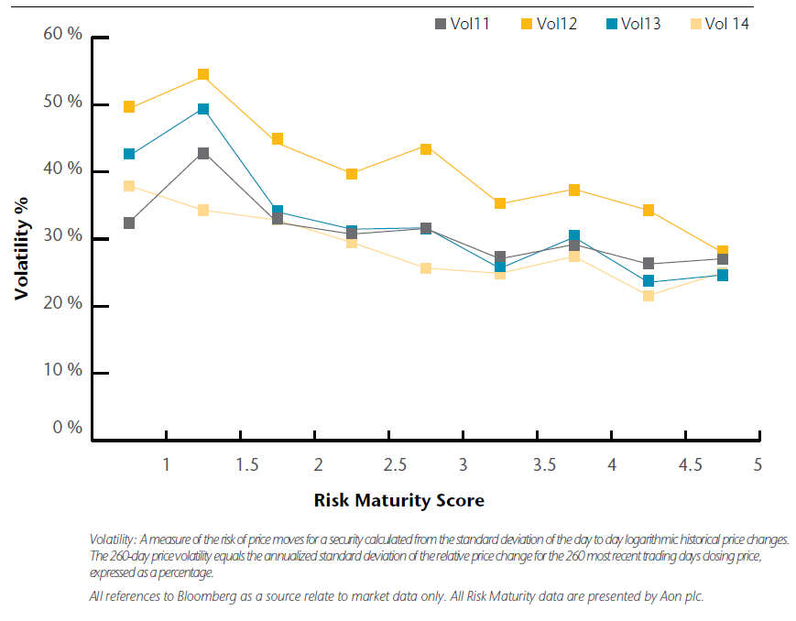
Risk Management Maturity and Stock Price Volatility
1 = Initial, 2 = Basic, 3 = Defined, 4 = Operational, 5 = Advanced
Source: Aon and Wharton research

Slide 7
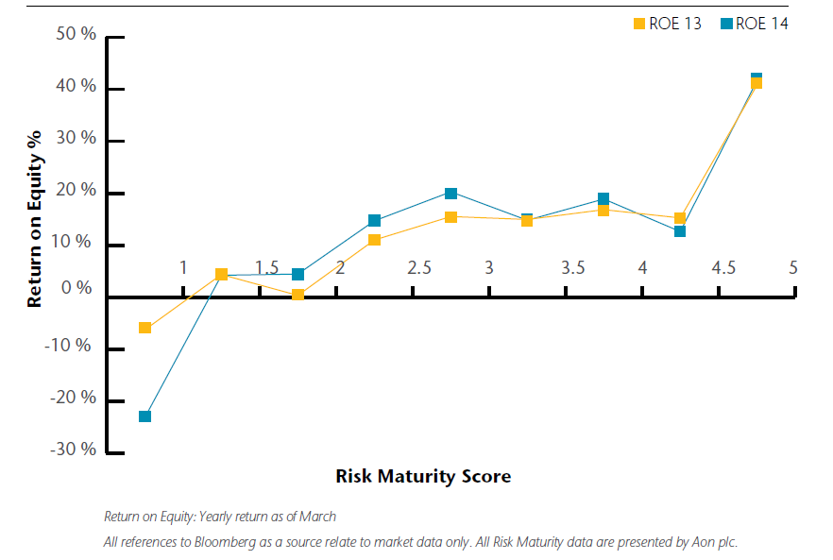
Risk Management Maturity and ROE
1 = Initial, 2 = Basic, 3 = Defined, 4 = Operational, 5 = Advanced
Source: Aon and Wharton research

Slide 8
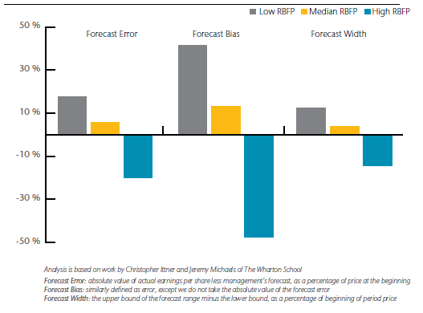
Risk-Based Planning and Forecasting and Earnings Forecasts
Estimated Percentage Difference From Average Earnings Forecast

Slide 9
THE BOARD HAS FOUR IMPORTANT RESPONSIBILITIES:
The Board determines the risk tolerance of the company, in consultation with management, shareholders, stakeholders.
The Board evaluates the company’s strategy and business model in the context of the firm’s risk tolerance.
The Board ensures the company is committed to operating at an appropriate risk level. It relies on risk KPIs (or KRIs) to help make this assessment.
The Board should satisfy itself that management has developed necessary internal controls and that procedures remain effective.

Slide 10
CPA Canada’s board risk oversight framework
I. Establish context
II. Identify risks
III. Analyze consequences (Quantify the impact of the risk and likelihood of occurrence)
IV. Analyze interconnectivities and compounding effects (Aggregate risks and understand relationships, interdependencies, and the compounding effect of simultaneous occurrences)
V. Re-analyze consequences (Re-calibrate and, if possible, create probability distributions of outcomes of interrelated risks)
VI. Prioritize
VII. Assess Risk Capacity, Tolerance and Risk Appetite (Determine the entity’s capability, tolerance and appetite for potential consequences of risk)
VIII. Choose Response Strategy (Avoid, reduce or control, share or insure, accept, or potentially exploit risks)
IX. Monitor (Continually measure and monitor the risk environment and the performance of the risk management strategies)

Slide 11
Types of risk disclosures
Risk factor categories
Prevalence of risk factor categories
Company-specific risk effects
Risk factor trends
Risk management efforts
Board oversight practices
Consideration of risk-taking incentives in executive compensation

Slide 12
CONCLUSIONS FROM IRRC INSTITUTE (2016) REVIEW OF U.S. RISK FACTOR DISCLOSURES
Streamline language around common risk factors
Offer more insightful, company-specific language
Enhance disclosure of risk mitigation efforts for key risks
Include greater use of company-specific detail; descriptions of how the nature, intensity and likelihood of key risks have changed or are likely to change; and explanations of how significant risks can affect the company’s business

Slide 13
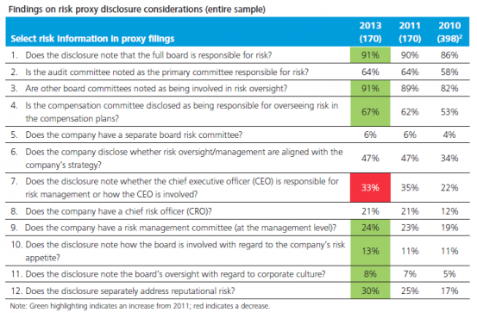
U.s. board oversight disclosures
Source: Deloitte (2014)

Slide 14
THE VAST MAJORITY OF THESE RISK DISCLOSURES ARE QUALITATIVE IN NATURE
Three partial explanations:
The internal development and use of Key Risk Indicators (KRIs) is limited
Risk appetites and tolerances are not adequately defined
Board members do not receive adequate risk-related information from management

Slide 15
The Use of Risk Performance Measures (KRIs)
Risk metrics and indicators are identified and tracked:
  22.2% rarely or never
  39.4% inconsistently or on an ad-hoc basis
  38.4% consistently for key risks
Identified risk metrics and indicators track:
  52.7% risk management activity implementation and completion
  33.9% resources used to implement and complete risk management activities
  56.3% risk exposure
Quantitative thresholds and tolerances have been established:
  28.4% no
  42.2% inconsistently or on an ad-hoc basis
  29.4% consistently for key risks
Source: Aon RMI Survey

Slide 16
The Use of Quantitative Risk Information
Executive-management has established a statement of risk appetite for the organization: No (39.9%); Yes, risk appetite has been informally discussed and understood (44.2%); Yes, risk appetite has been formally defined and documented (19.2%)
Executive-management has established statements of risk tolerance for key risks: No, risk tolerance statements have not yet been developed (36.6%); Yes, for some key risks (44.2%); Yes, for key risks (19.2%)
Risk assessment criteria are developed to align with: Risk assessment criteria are not developed (16.9%); Management perceptions of risk tolerance (63.6%); A quantified risk appetite and statements of risk tolerance (19.5%)
Risk drivers are identified/documented: Rarely or never (6.4%); Inconsistently or on an ad-hoc basis for selected risks (42.4%); Consistently for key risks (51.2%)
Executive management applies concepts of risk appetite/tolerance to strategy development: Rarely or never (26.8%); On an ad-hoc basis (59.6%); Through formal process (13.6%)
Source: Aon RMI Survey

Slide 17
The Integration of Performance and Risk Management
Source: IBM/Wharton Survey

Slide 18
Board Risk Oversight Practices
←
←
Source: Aon RMI Survey

Slide 19
Board Risk Oversight Practices
←
←
←
Source: Aon RMI Survey

Slide 20
Board Risk Oversight Practices
←
←
←
Source: Aon RMI Survey

Slide 21
A Conceptual Model for Potential Disclosures
Board effectiveness is a function of the process the Board follows when carrying out its monitoring and advising roles.
Board Risk Oversight Responsibility
Board Risk Oversight Involvement
Risk Management Processes
Risks and Risk-Taking
(Risk Types)
No formal assignment
Committee only
Board only
Board & committee
Board understanding
Board reporting
Board & management alignment
Board & risk manager communication
Currently, the correlation between risk disclosures and
actual risk management and oversight practices is fairly low
Source: Ittner and Keusch (2017)
Notes:
We follow prior research and argue that the effectiveness of Board monitoring and advising is a function of the process through which these activities are carried out.
The process proposed in the literature begins with the formal assignment of responsibilities for risk oversight, which facilitates actual involvement in risk oversight activities, leading in turn to more mature risk management processes, and ultimately determining firm risk-taking.
We will test for direct and indirect effects between these components.
The first 4 mutually exclusive responsibility locations that we consider are NO FORMAL ASSIGNMENT of responsibilities for risk oversight, ASSIGNED TO COMMITTEE(S) ONLY, for example to the audit committee, ASSIGNED TO FULL BOARD ONLY without committee responsibilities, and ASSIGNED TO BOARD AND COMMITTEE(S). An additional location choice that we consider is whether or not the Board has a STAND-ALONE RISK COMMITTEE.
The Board involvement dimensions considered are whether the Board’s UNDERSTANDING of risks and risk management is discussed during Board meetings, the quality and frequency of risk REPORTING to the Board, whether Board and top management have reached ALIGNMENT with respect to risk appetite and risk management strategy, and whether the Board and the RISK MANAGER COMMUNICATE outsider of regular Board meetings.
Involvement
Understanding (top risks; existing risk management activities; quantified risk appetite; emerging risks)
Reporting frequency and content (key risks, risk drivers, risk ownership, risk mgmt action plans, risk tolerances, risk performance metrics, emerging risks; frequency to Boar, frequency to Board committees)
Alignment with top management (Board & top mgmt. are aligned on risk management strategy; risk mgmt strategy aligned with overall strategy)
Direct communication with risk leader (outside of regular Board meetings)
Risk management maturity
Top mgmt. stewardship
Risk communication
Risk culture
Risk identification
Stakeholder participation in risk management
Risk information and decision making
Integrated risk management in human capital processes
Risk analysis and quantification
Focus on value creation

