Slide 1
Professional Accounting Futures University of Toronto Mississauga
September 15, 2017
Steven Huddart

Slide 2
Plenary Session of the 2017 AAA meetings
Bob Swieringa (dean, FASB, GE director),
Kathy Schrand (founding editor of the Journal of Financial Reporting), and
Bob Kaplan (the Dwight Eisenhower of Accounting)
offered perspectives on making research more relevant to practitioners.

Slide 3
My take-aways
Bob: strengthening connections to practice
Spend more time speaking with practitioners. Go to THEIR conferences. Read THEIR professional work (including professional journals, laws, regulations, court records).
Kathy: enhancing the journal review process
Do more exploratory and descriptive research. Publish it.
Senior faculty should write monographs and contribute to handbooks.
Bob: revisions to academic performance evaluation
Stop sending your work to the most prestigious journals. Sent it to the journal with the best audience for your work.
Measure faculty time spent on outreach.

Slide 4
Research types
Ex ante modeling or experiments of proposed regulatory regimes
Ex post evaluation, using archival/empirical methods, of regulatory consequences

Slide 5
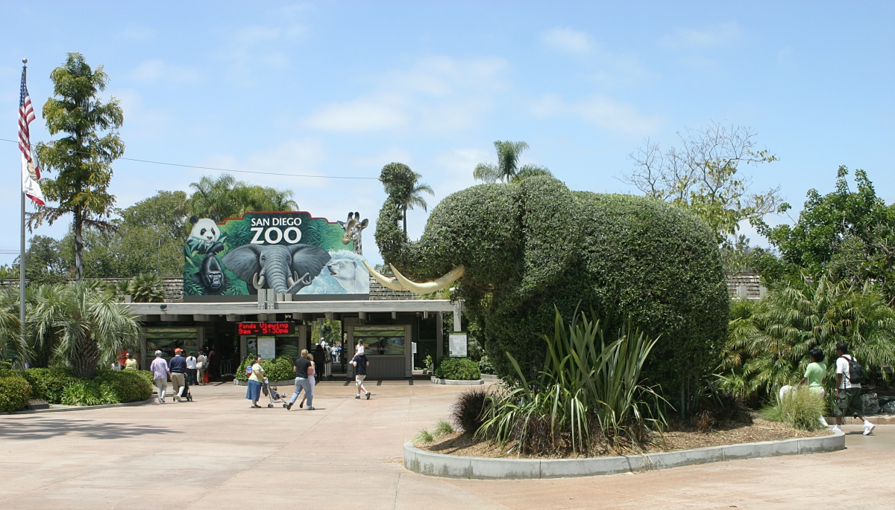
Lab/Zoo/Safari

Slide 6
PCAOB = CPAB + ASB
PCAOB: Public Company Accounting Oversight Board
CPAB: Canadian Public Accountability Board
ASB: Auditing Standards Board

Slide 7
SOX: Oh, the jobs people work at!
Out west, near Hawtch-Hawtch,
there's a Hawtch-Hawtcher-Bee-Watcher.
His job is to watch . . .
is to keep both his eyes on the lazy town bee.
A bee that is watched will work harder, you see.
Well . . . he watched and he watched.
But, in spite of his watch,
that bee didn't work any harder. Not
Mawtch.
So then somebody said,
`Our old bee-watching man
just isn't bee-watching as hard as he can.
He ought to be watched by another Hawtch-Hawtcher.
The thing that we need is a Bee-Watcher-Watcher!’
WELL . . .
The Bee-Watcher-Watcher watched the Bee-Watcher.
He didn't watch well. So another Hawtch-Hawtcher
had to come in as a Watch-Watcher-Watcher.
And today all the Hawtchers who live in Hawtch-Hawtch
are watching on Watch-Watcher-Watchering-Watch,
Watch-Watching the Watcher who's watching that bee.
You're not a Hawtch-Hatcher. You're lucky, you see!
T. Geissel (Dr. Seuss)

Slide 8
Hawtch-Hawtchers
Preparer (and internal quality assurance)
External audit (and internal quality assurance)
Regulatory review
To what extent have PCAOB/CPAB inspection staff been hired away by public accounting firms? With what effect?

Slide 9
John Veihmeyer, Chairman, KPMG International
"Inspection process in the US is so onerous and the standardization (regardless of utility) and zero-defect mentality so oppressive that audit partners KPMG would like to retain are leaving the firm for more rewarding work.

Slide 10
Timeline
February 2017
KPMG whistleblower reports that an employee who formerly worked for the PCAOB received and shared confidential information with other KPMG employees
KPMG informs PCAOB and SEC
KPMG and PCAOB hire law firms to investigate
PCAOB employee who leaked information leaves the PCAOB
April 11 2017
KPMG dismisses 6 employees:
Scott Marcello, vice chairman of audit (and former FASB fellow)
David Middendorf, national managing partner of audit quality and professional practice responsible for dealing with the PCAOB
3 unidentified partners
1 unidentified employee
Among the Big Four, KPMG has had the highest number of deficiencies cited by the accounting board in 2015 and 2016
The rate of deficiencies found by the PCAOB grew from 22% in 2010 to 54% in 2014

Slide 11
Defects only
What are the implications of a "defects only" audit inspection model?
Defects only: measure audit quality on a scale running from terrible to acceptable.
Does this inspection model encourage a strategy of just meeting the minimum threshold for acceptable audit quality?

Slide 12
Inspection Outcomes
SF Partnership, LLP
Examined by PCAOB in 2011 and 2016.
Deficiencies found in 2011.
Fewer issuers and a smaller staff in 2016.
Good/bad for SF? The profession?
How prevalent are these problems?
Why was this examination conducted by the PCAOB, not CPAB?

Slide 13
Post-Implementation Review
For USA: PCAOB’ Form AP
More information about individual partners' reputations leading to less value attached to firms' reputations?
What effects will this have on firms' quality control efforts?
For Canada:
How has the reorganization and consolidation of professional accounting bodies affected members of the profession? Members of the public?

